Slide 1
New DM NVX® 10/20/200 AV-over-IP Encoders and Decoders
Affordable, quality content sharing for every participant.
Designed for everyday use in meeting rooms, collaboration spaces, and classrooms.

Slide 2
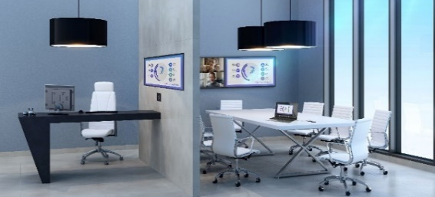
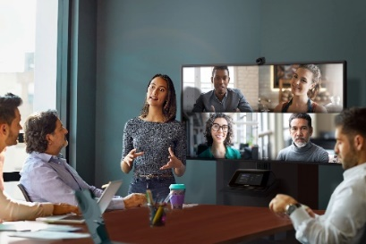
The Trend
Increased demand for dynamic and engaging content with a higher volume of displays in more places, driving up overall demand for video content
Expansion of video into more spaces throughout campuses/buildings, a trend accelerated by hybrid work
Lower occupant density driving collaborators and meeting participants to multiple locations, even when in the same location
Migration to networked video (AVoIP), utilization of existing network to distribute AV content

Slide 3
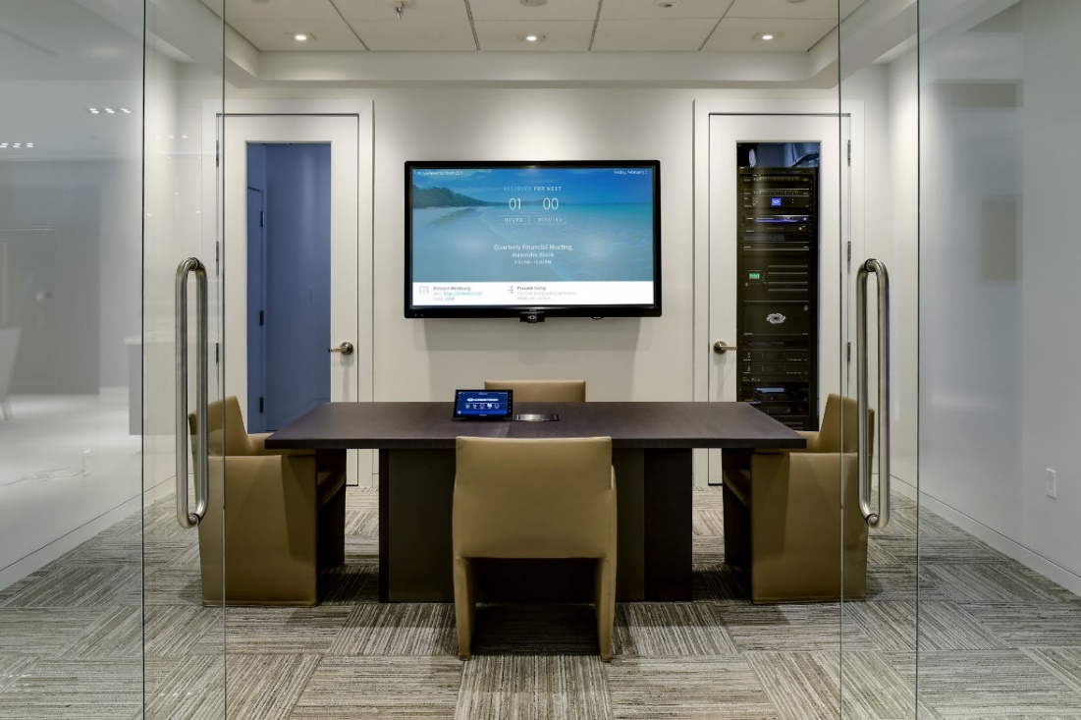
The Challenges
Scalability – Ability to scale as needs evolve. Interoperability between various technologies. Fast deployment.
Control / Management – Management of multiple signal formats and diverse resolution requirements across a multitude of spaces. Minimal complexity and little technology downtime
Affordability - quality solutions that work within budget
Security – Support of existing risk mitigation and compliance standards
Leverage existing infrastructure – Immersive audio and video, while operating within the network requirements of existing infrastructure.

Slide 4
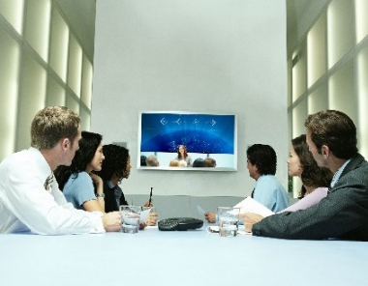
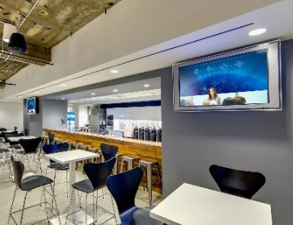
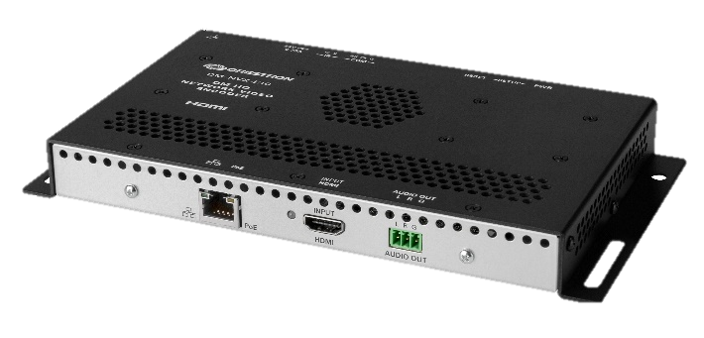
DM NVX® 10/20/200 AV-over-IP Encoders and Decoders
One Solution: DM NVX® Encoders and Decoders (DM NVX® 10/20/200)
Crestron® Network Video Solutions are designed for simple point-to-point display and global distribution using your existing network infrastructure and security protocols.
1080p60 4:4:4
Network AV Encoder (DM-NVX-E10)

Slide 5
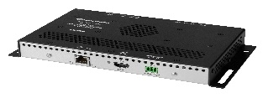
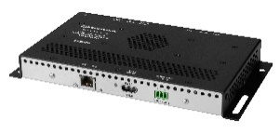
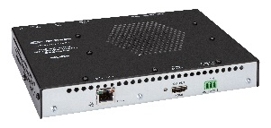
DM NVX® 10/20/200 AV-over-IP Encoders and Decoders
One Solution: DM NVX® Encoders and Decoders (DM NVX® 10/20/200)
New DM NVX® interoperable, point-to-point encoders and decoders are designed to provide:
Scalable: Add, change, update as needs evolve
Control / Management: Easy to manage and maintain remotely
Affordable: Cost-optimized solutions that work within your budget
Security: Enterprise Grade Security Support
Leverages existing infrastructure: Quality audio and visual on existing network requirements
Encoders
1080p60 4:4:4 Network AV Encoder (DM-NVX-E10)
4K60 4:2:0 Network AV Encoder (DM-NVX-E20)
Decoders
1080p60 4:4:4 Network AV Decoder (DM-NVX-D10)
4K60 4:2:0 Network AV Decoder (DM-NVX-D20)
Decoder
with Scaler
4K60 4:2:0 Network AV Decoder with Scaler
(DM-NVX-D200)

Slide 6
At a Glance
Networked Video Solutions (AVoIP)
Online videos slated to make up
of all consumer internet traffic
+44%
Collaboration
Tools
75% of meetings
More than 82%
Increase in usage since 2019
Estimated to be conducted by video
By 2022…15 times higher than 2017.**
Est. 79% using digital workplace technology***
By the year 2024 (up from 40% in 2019)*
Trend | Challenge | With DM NVX® 10/20/200
Increased demand for hybrid meeting space | Integrating an in-room video conferencing and in-person meeting space. | Low latency video, lossless audio. Delivers real-time, full-motion video performance, designed to support the needs of hybrid collaboration.
Increase need/volume of collaboration tools / devices | Technology that is expandable | Easy to scale with full interoperability. Add, change or move end points easily with no limit on number of end points (inputs / outputs). Interoperable with Crestron ecosystem and any signal format / device. Quick setup of endpoints via web.
Increased number of end points and spaces | Management of all end points to ensure uptime and maintain productivity. | Remotely view, monitor, access, and control technology saving time. No need to physically enter room / handle device. Proactive alerts bring attention to issues so they can be resolved ahead of time, reducing negative impacts on space productivity.
Highly engaged in-room collaboration | Affordable, connected spaces that also deliver quality audio and video content for all users | Variety of high-quality solutions available at an affordable price point. Innovative, value-added, DM NVX® firmware updates go beyond bug fixes to enhance system power, add additional features, further lowering, overall cost of ownership and extending product lifecycles.
Higher standards for risk mitigation and compliance policy | Implementation of user-friendly technology that supports these standards. | Supports enterprise grade security protocols encryption, device and user access associated with risk and compliance standards.
Increase usage of video | Increase in bandwidth consumption | Utilizes existing network architecture. Quality signal distribution on both 1gb and 10Gb networks.
*Data provided by TechRepublic, original source Gartner. | **Per Forbes magazine, State of Online Video | ***Data provided by Gartner.

Slide 7
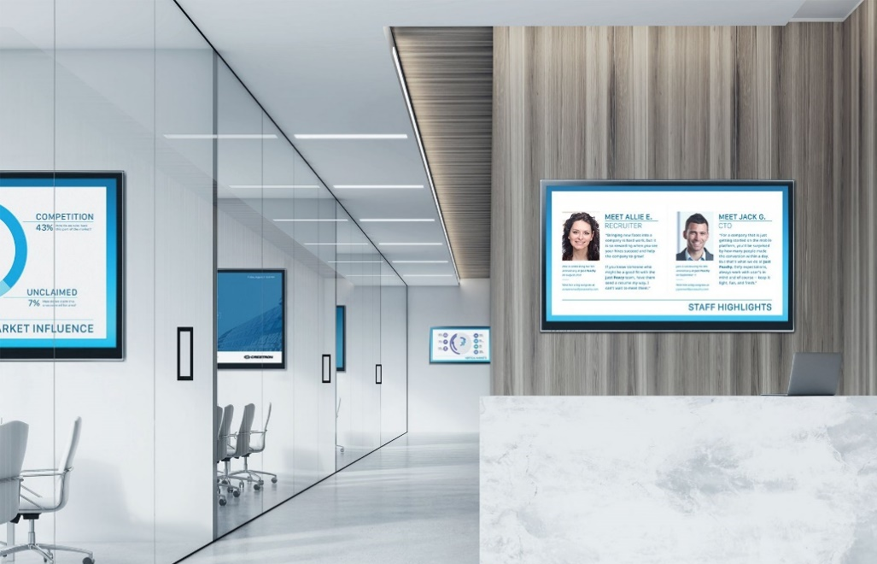
Scalability and Flexibility
One Solution: DM NVX® Encoders and Decoders (DM NVX® 10/20/200)
Design robust, comprehensive in-room experiences, with complete interoperability and performance
Seamless integration with:
Any signal format and device (displays, cameras, mics)
Crestron ecosystem (Crestron FLEX, Control), and other complimentary products
Expand, change or move system as needs evolve:
Add new endpoints seamlessly
Variety of options to choose from to expand your system, works alongside other DM NVX® x3x solutions. Easy to deploy.
Convenient web-based setup of endpoints, readies space for use, faster
Scalability and Flexibility
Manage and Control
Affordable
Security
Leverages existing network

Slide 8
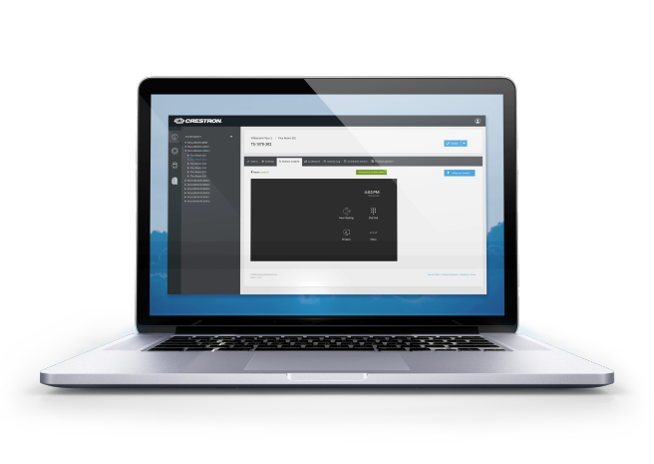
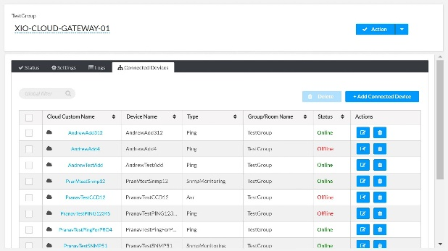
Manage and Control
One Solution: DM NVX® Encoders and Decoders (DM NVX® 10/20/200)
Save time by streamlining the IT management of an increased number of end points and technologies across your broader organizations.
DM NVX® 10/20/200 solutions are backed by the powerful DigitalMedia™ platform:
Simple web-based tools for remote configuration, management, routing, monitoring, and troubleshooting
Allows the management of multiple devices, across multiple spaces and signal formats, with diverse resolution requirements
Receive issue alerts, then proactively take control of the technology remotely to resolve issues
Push / schedule firmware updates, remotely
Scalability and Flexibility
Manage and Control
Affordable
Security
Leverages existing network

Slide 9
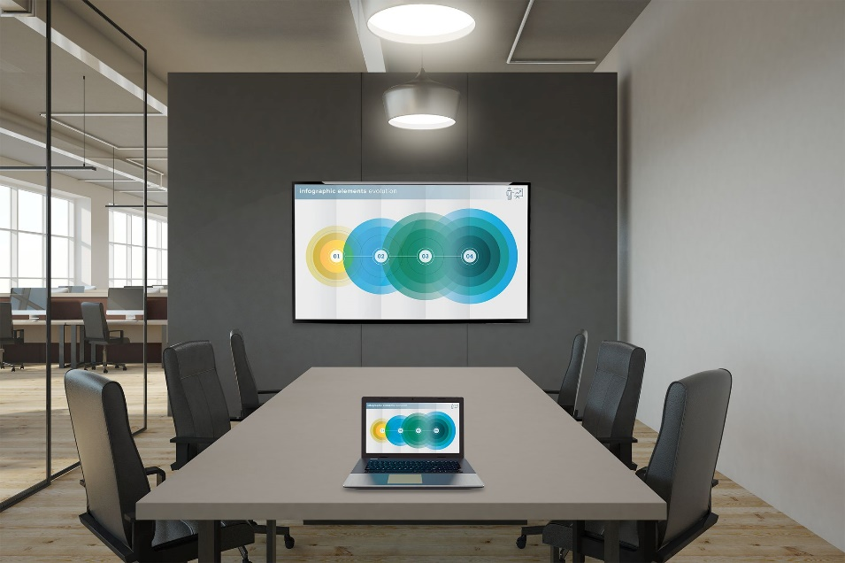
Affordability
One Solution: DM NVX® Encoders and Decoders (DM NVX® 10/20/200)
Choose an encoder / decoder with ideal specs for the source resolution and your budget:
Not every source is 4K/60 4:4:4 (cable boxes, digital signage devices, etc.
DM NVX offers best quality for meeting spaces, classrooms and other applications with specified resolutions of 1080p – 4K60 4:2:0
Delivers the best hardware for your application and budget, with the best performance at every price point.
Value-added, product-enriching remote firmware updates :
Enhances system power, adds additional features, delivers enhanced end user experience
Lowers, overall cost of ownership and extends product lifecycles
Requires less power and network requirements, leveraging standard PoE, versus PoE+ or PoE++, resulting in greater cost-savings
Scalability and Flexibility
Manage and Control
Affordable
Security
Leverages existing network

Slide 10
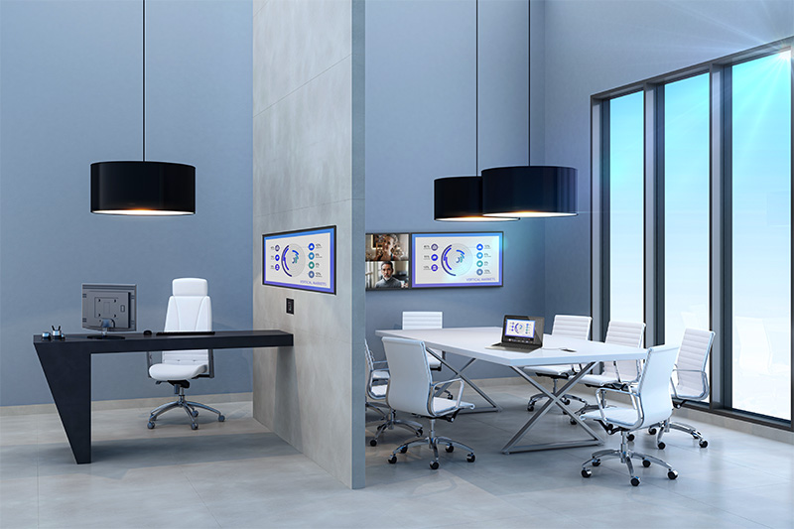
Security
One Solution: DM NVX® Encoders and Decoders (DM NVX® 10/20/200)
Adhere to stringent IT security policies:
Supports enterprise-grade security protocols
Highly secure and supports your existing risk mitigation and compliance standards
Addresses content encryption, device access, and user access to reinforce organizational risk mitigation and compliance policies
Stay at the forefront of security by remotely pushing updates as they are released
Scalability and Flexibility
Manage and Control
Affordable
Secure
Leverages existing network

Slide 11
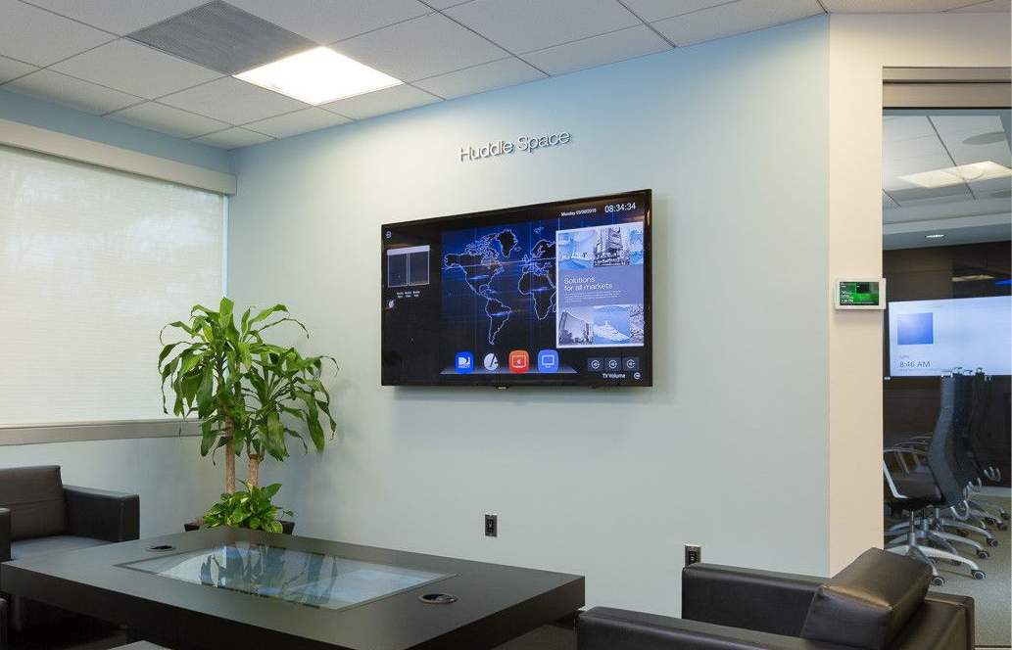
Leverages existing infrastructure
One Solution: DM NVX® Encoders and Decoders (DM NVX® 10/20/200)
Utilizes existing infrastructure within existing network requirements
Designed for both 1Gb and 10Gb networks
Maintains the highest level of audio and video to provide the best overall participant and user experience:
Delivers real-time, smooth, full-motion, video performance
Lossless, surround sound
Crisp audio with no lag time or delays
Independent audio routing
Scalability and Flexibility
Manage and Control
Affordable
Security
Leverages existing network

Slide 12
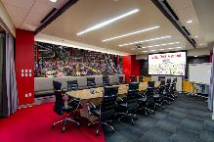
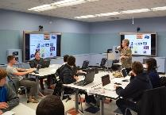
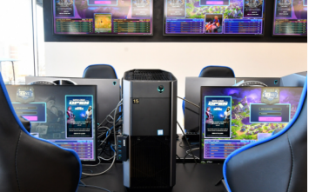
Support a Wide Range of Applications
One Solution: DM NVX® Encoders and Decoders (DM NVX® 10/20/200)
Delivers real-time, full-motion 4K60 video performance, ideal for:
Presentation of multimedia
Video conferencing
Live camera images / video
Engineered for stability, reliability, and the audio and visual demands of:
Classrooms / education (Higher Ed & K-12)
Small conferencing & collaboration Spaces
Hybrid spaces (video conferencing)
Digital Signage: perfect synchronization of content across multiple displays (Line‑synchronized outputs)
High-demand applications: command-and-control centers, simulation centers, esports, and courtrooms
Hybrid / Video Conferencing
Small Conference / Collaboration Spaces
High-Demand
Applications
Digital Signage
Classrooms / Education
(K-12, Higher Ed)
esports
Notes:
For line diagrams and drawings, reference the ‘NVX E10D102-200 September PIF.ppt’ (located in HighSpot)

Slide 13
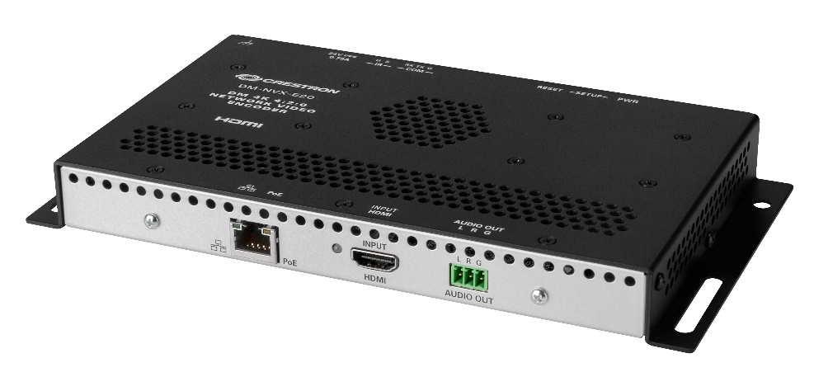
Technical Overview: DM NVX 10/20/200
One Solution: DM NVX® Encoders and Decoders (DM NVX® 10/20/200)
Highest video integrity, regardless of output
Delivers real-time, full-motion video performance
Scaling option available (DM-NVX-D200)
Video has virtually no latency, supported by high refresh rates and lossless compression
Solutions to support 1920x1080p, 4K30 4:4:4, and 4K60 4:2:0
Audio Clarity
Lossless transfer of surround sound audio signals
Stereo 2-Channel
Digital HDMI®, AES67 • Dolby Digital® • Dolby Digital EX • Dolby Digital Plus • Dolby® TrueHD • Dolby Atmos® • DTS® • DTS-ES • DTS 96/24 • DTS HD • High Res DTS HD® Master Audio™ • LPCM up to 8 channels
Installs and Connects with Ease
Simple web-based setup via web browser
Designed to meet the evolving needs of your space
Easy, low-voltage installation. Powered via PoE (optional power pack also available). No need for fiber or added electrical runs.
Mounts conveniently, small footprint: fits behind flat-panel displays, above ceiling-mounted projectors, in AV cart / cabinet
Network
Networked AV (AVoIP), utilizes existing network and security protocols; supports interoperability between devices

Slide 14
Choose Your Solution
 |  | DM-NVX-E20 | DM-NVX-E10 | DM-NVX-D20 | DM-NVX-D200 | DM-NVX-D10
 |  | Encoder |  | Decoder
Video
Pixel Perfect Processing
4K60 4:4:4
4K60 4:2:0 |  | ✓ |  | ✓ | ✓
4K30 4:4:4 |  | ✓ |  | ✓ | ✓
1920x1080p |  | ✓ | ✓ | ✓ | ✓ | ✓
Scaler |  |  |  |  | ✓
HDR | HDR10+ | Dolby Vision® standard
Audio
Stereo 2-Channel |  | ✓ | ✓ | ✓ | ✓ | ✓
Digital HDMI® |  | ✓ | ✓ | ✓ | ✓ | ✓
DSP Downmix
Dante
Audio Standards |  | AES67 • Dolby Digital® • Dolby Digital EX • Dolby Digital Plus • Dolby® TrueHD • Dolby Atmos® • DTS® • DTS-ES • DTS 96/24 • DTS HD • High Res DTS-HD® Master Audio™ • LPCM up to 8 channels
Connectivity
 | HDMI Input | 1 | 1
 | HDMI Output |  |  | 1 | 1 | 1
Power Supply |  | PoE | PoE | PoE | PoE | PoE
Security & Support |  | 802.1x / AES-128 / Active Directory® / TLS / HTTPS / SSH / SSL / SFTP
Supports Enterprise-Grade Security |  | ✓ | ✓ | ✓ | ✓ | ✓
Resolution Support (Crestron True Blue Support) |  | ✓ | ✓ | ✓ | ✓ | ✓
XiO Cloud® & Native Configuration on Tools |  | ✓ | ✓ | ✓ | ✓ | ✓
Select the performance, features, and budget that best suits your application
These five new DM NVX® encoders and decoders round out the broader DM NVX® offering and have been engineered for the highest level of quality, and highest level of integrity
Need to support higher resolutions?
For additional offerings and capabilities, including 4K60 4:4:4, view the balance of the DM NVX® family of products here or compare additional solutions on the comparison chart here.
1080p60 4:4:4 Network AV Encoder (DM-NVX-E10)
1080p60 4:4:4 Network AV Decoder (DM-NVX-D10)
4K60 4:2:0 Network AV Encoder (DM-NVX-E20)
4K60 4:2:0 Network AV Decoder (DM-NVX-D20)
4K60 4:2:0 Network AV Decoder with Scaler
(DM-NVX-D200)
HD-PS401
HD-PS402

Slide 15
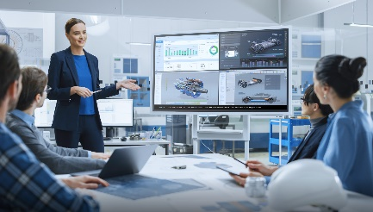
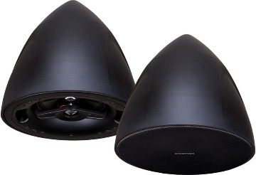
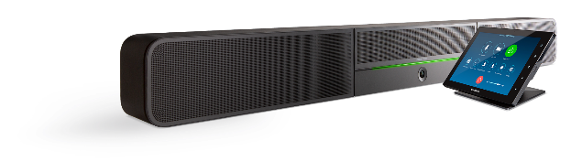
The Crestron Ecosystem
Interoperable DM NVX® encoders and decoders work seamlessly within the Crestron Ecosystem to elevate your meeting audio and video experience:
Crestron Flex: BYOD Wireless Conferencing
AirMedia® Wireless presentation and collaboration system
Crestron Flex Video Soundbar
Speakers
Crestron Flex
AirMedia®
Crestron Flex Video Soundbar
Speakers

Slide 16
Ready to Learn More?
Learn More
Contact your Crestron representative to get started:
Representative Name
Phone Number
Email
FPO

Slide 17
Thank you
All brand names, product names, and trademarks are the property of their respective owners. Certain trademarks, registered trademarks, and trade names may be used in this document to refer to either the entities claiming the marks and names or their products. Crestron disclaims any proprietary interest in the marks and names of others. Crestron is not responsible for errors in typography or photography. © 2022 Crestron Electronics, Inc.

