Slide 2
Crestron Flex Intelligent Communications for the Modern Workplace

Slide 3
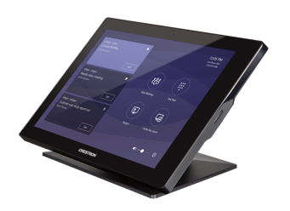
Crestron Flex
A productive, stress-free experience throughout the workday

Slide 4
Crestron Flex – Collaboration that works. In every way.
One Solution
8:00 AM
The day begins
9:15 AM
Emergency meeting
10:00 AM
Team meeting
12:00 PM
Global meeting
3:30 PM
Training session
Notes:
8:00 AM - The day begins
In your office, Crestron Flex P100 voice devices provide you with your day’s calendar and connect you with coworkers and customers alike.
9:15 AM - Emergency meeting
Your colleagues need to review a spreadsheet before the team meeting. No problem. Crestron scheduling touch screens connect to your calendaring system. It indicates a nearby huddle room is available. You book it on the spot.
10:00 AM - Team meeting
Your colleague quickly pairs her Bluetooth® device to the Crestron Flex M100 tabletop conferencing system and you all discuss in real-time.
12:00 PM - Global meeting
As you head to your next meeting, the illuminated Crestron room availability hallway signs help you easily locate the room. As you enter, your team’s name is on the display and the same interface greets you on a 10" touch screen.
The Crestron Flex B100 Series smart soundbar provides crystal clear voice pickup around the room. One touch and everyone is connected to the room, along with the UK leadership team. On-time. Efficient.
3:30 PM - Training session
Joining the session is simple. The Crestron Flex C100 Integration Kit provides an intuitive interface, even in the most complicated spaces, giving meeting facilitators the confidence they need to have a great session.

Slide 5
Crestron Flex – Collaboration that works. In every way.
One Experience:
Consistent Microsoft user experience, from desktop to boardroom
Exceptional audio and image quality
Simplifies and speeds installation, deployment, management, monitoring, and evolution of devices, locally and globally
Zero-touch Cloud-based management solution hosted on Microsoft® Azure® platform

Slide 6
Crestron Flex – Collaboration that works. In every way.
w
One Touch to:
Initiate calls, presentations, videoconferencing and more
Book a meeting – integrates with room scheduling to check room availability
Start video, lower shades, adjust lighting and temperature – integrates with advanced video controls and smart building ecosystems

Slide 7
Crestron Flex – Collaboration that works. In every way.
One Partnership
Only Crestron has been a partner through every generation of Microsoft room systems
Crestron Flex is latest, most robust result of that partnership
UC solution that realizes the full potential of every aspect of the Microsoft ecosystem

Slide 8
Crestron Flex – Collaboration that works. In every way.
P-Series
Voice-over-IP desk phone
M-Series
Tabletop conferencing system
B-Series
Front of Room Smart Soundbar
C-Series
Flexible, integrated UC kit

Slide 9
Crestron Flex P-Series

Slide 10
Crestron Flex P-Series
Not just a phone – a hub for collaboration
Smart desk phone connects to contacts, calendar and meetings
Connects to network with latest security standards
Zero-touch provisioning and centralized management
Native Voice

Slide 11
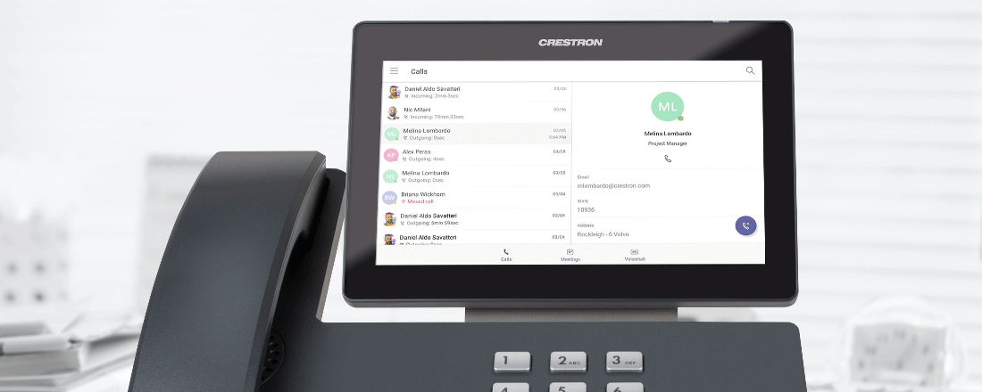
Crestron Flex P-Series
Experience
Natively runs Microsoft Teams™ with one touch join. Manage contacts. Join a meeting or book a meeting. See your day.

Slide 12
Crestron Flex P-Series
Cloud Enabled
Hosted on Microsoft Azure, Crestron XiO Cloud™ service provides zero-touch provisioning and centralized management

Slide 13
Crestron Flex P-Series
Installation

Slide 14
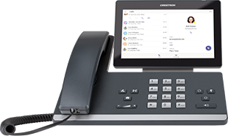
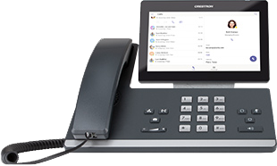
Crestron Flex P-Series
UC-P100-T
VoIP Desk Phone
UC-P100-T
VoIP Desk Phone w/ Tilt Screen

Slide 15
Crestron Flex M-Series

Slide 16
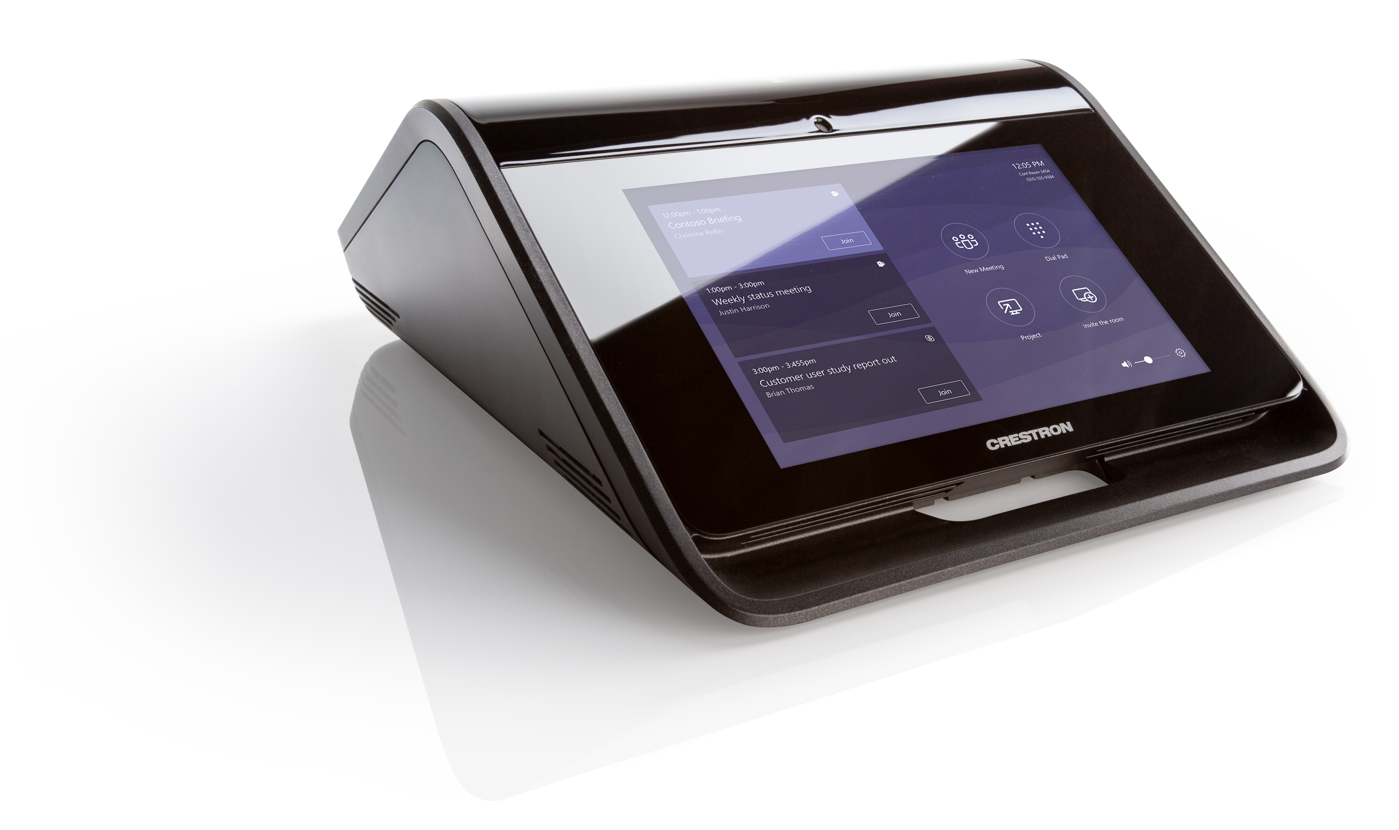
Crestron Flex M-Series
All-in-one tabletop console – the core of modern meeting spaces
Call, collaborate, present and video conference with one touch
Exceptional microphone and speaker quality
Isolated acoustics
360 degree quad microphones
Zero-touch provisioning and centralized management
Native Voice or Room System

Slide 17
Crestron Flex M-Series
Quad array microphones
Quad array microphones with a range of 20 feet picks up every voice at the table.

Slide 18
Crestron Flex M-Series
Isolated Acoustic
Reduces rattling and raspy voices so remote voices sound as good as the ones in the room.

Slide 19
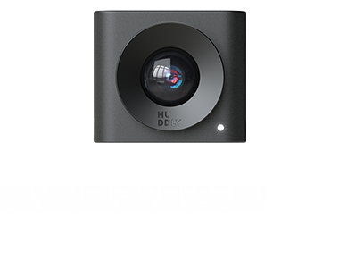
Crestron Flex M-Series
Intelligent 4K Camera
Ultra-wide angle
AutoZoom
Intelligently frames around participants
Dynamic light optimization
Auto white balance
Automatic lossless digital zoom
People counting

Slide 20
Crestron Flex M-Series
Room Controls
Flex button connects to advanced video options and smart building ecosystems:
Switch video
Adjust audio
Lower the shades
Set the lighting
Change the temperature

Slide 21
Crestron Flex M-Series
Installation

Slide 22
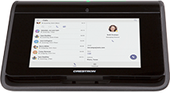
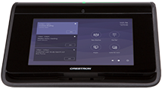
Crestron Flex M-Series
UC-M100-T
Audio Conference system
UC-M130-T
Single display video conference system
UC-M150-T
Dual display video conference system w/ intelligent camera

Slide 23
Crestron Flex B-Series

Slide 24
Crestron Flex B-Series
Complete room solution in a wall-mount soundbar form factor
Full range speakers and beam forming microphone ensure exceptional audio quality
Optional, integrated wide angle 4K camera with auto zoom and people counting
Streamlined installation: mount using integrated bracket, connect power and USB
Zero-touch provisioning and centralized management
Native Room System

Slide 25
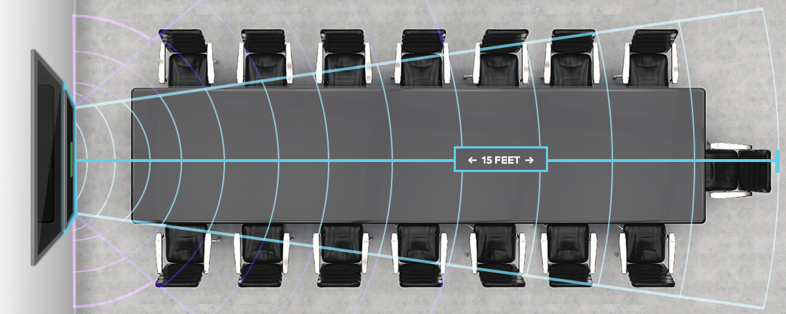
Crestron Flex B-Series
Beam Microphones
Employs adaptive beam forming technology with a range of 15 feet. Picks up whoever is speaking with pinpoint precision. Amplified speakers support a full range of HD-audio, so the richest content has the fullest sound
*** Note: The microphone pickup range may be less within rooms that have a highly reflective infrastructure (e.g., glass walls, metal furniture, open ceilings etc.) and/or above average ambient noise.

Slide 26
Crestron Flex B-Series
Dynamic light optimization, auto white balance, wide angle, people-counting and automatic lossless digital zoom intelligently frames around participants.

Slide 27
Crestron Flex B-Series
A sound solution for any room. Just connect via USB.

Slide 28
Crestron Flex B-Series
Installation

Slide 29
Crestron Flex B-Series
Single Display Conference System
Dual Display System
Native Room Systems
UC-B140-T
Single display video conference system w/ intelligent camera
UC-B160-T
Dual display video conference system w/ intelligent camera
BYOD Soundbars
UC-SB1
Audio Conference Smart Soundbar
UC-SB1-AV
Video conference smart soundbar with HD camera
UC-SB1-CAM
Video conference smart soundbar with integrated, intelligent camera

Slide 30
Crestron Flex B-Series
Crestron Flex Smart Soundbars are available as a standalone USB option
Bring crystal clear audio and video to any space
UC-SB1
UC-SB1-AV
UC-SB1-CAM

Slide 31
Crestron Flex C-Series

Slide 32
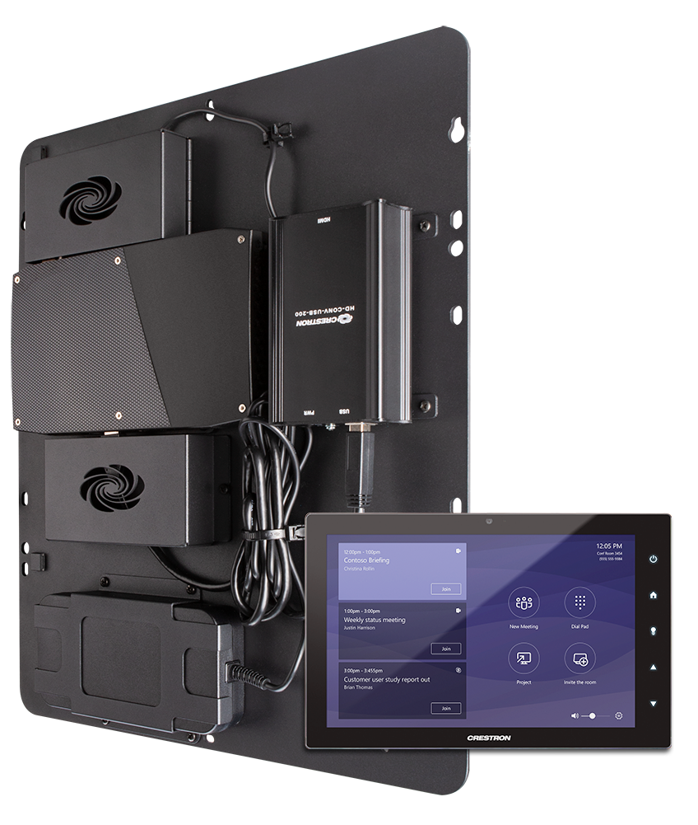
Crestron Flex C-Series
Simple, flexible solution for building customized systems for complex, demanding spaces of any size
Integrates with any existing room system to add native UC support
Call, collaborate, present, and video conference with one touch
Integrates with Audio, Video, Lighting, shades, and HVAC for one touch room control
Streamlined installation
Zero-touch provisioning and centralized management
Native Room System

Slide 33
Crestron Flex C-Series
Turnkey
Supports spaces of any kind
Integrates with any existing system
Out-of-the-box functionality to implement Microsoft Teams and support any space

Slide 34
Crestron Flex C-Series
Bring the power of Microsoft Teams to any space.

Slide 35
Crestron Flex C-Series
Room Controls
Flex button connects to advanced video options and smart building ecosystems:
Switch video
Adjust audio
Lower the shades
Set the lighting
Change the temperature

Slide 36
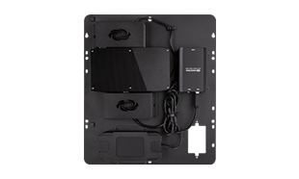
Crestron Flex C-Series
UC-BRKT-100-ASSY
Upgrade for existing Crestron rooms or Crestron Mercury® systems
UC-C160-T
Video conference integrator kit

Slide 37
Solutions for today, ready for the demands of tomorrow
w
Hosted on Microsoft Azure IoT platform and natively built into Crestron Flex solutions
Deploy quickly and securely
Manage remotely and proactively
Monitor instantly
Evolve confidently

Slide 38
Solutions for today, ready for the demands of tomorrow
w
Committed to client and partner support
24/7
Local support, globally
“Always on” cloud-based management support
Support for every device, from oldest to newest
Enterprise-grade security
5-year warranty

Slide 39
Crestron Flex

