Slide 2
Crestron Commercial Lighting

Slide 3

Crestron the company
A Partner you can trust
  Privately held company
  Not part of a conglomerate fixture manufacturer
  Based in NJ
  Build products around industry standards
  REAL control solutions for tunable white
  90% of all F500 Companies use Crestron
  American-built products under NAFTA

Slide 4

Crestron the company
A Partner you can trust
  Growth through innovation
  Earning countless product innovation awards
  Hundreds of engineers committed to push the boundaries of what is possible
  Deep, long-standing partnerships with world tech giants such as Microsoft, Apple, Cisco, Intel, etc
  Focused on creating new and innovated solutions for new generation.
    Zūm
    Solar Sync

Slide 5
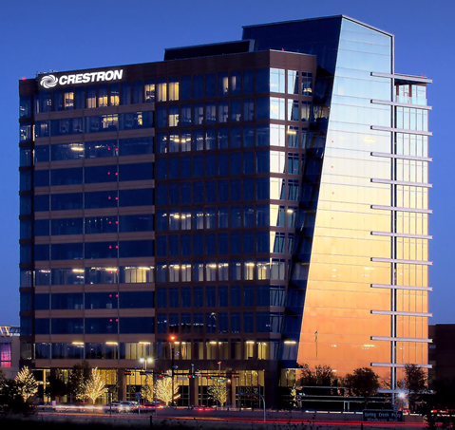
Crestron the company
A Partner you can trust
  Expansion into new locations
  2017 New South West campus opened in Plano, TX
  2019 New Distribution center located in Dallas, TX

Slide 6
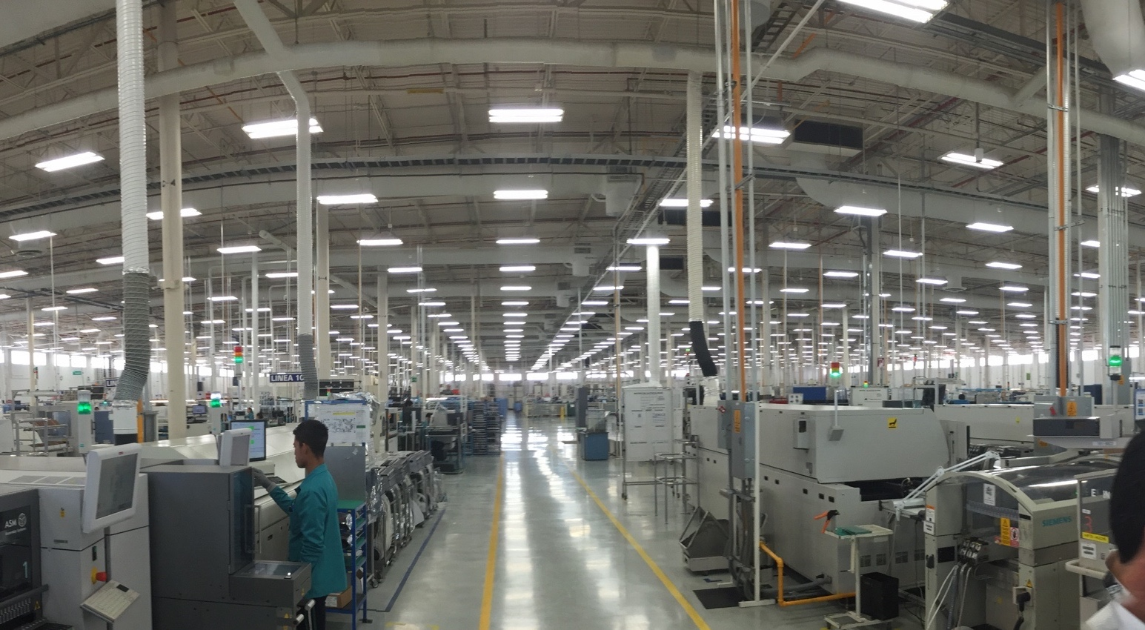
Three (3) Mexico factory locations 900K SF

Slide 7
2019 New 100K SF factory in New York

Slide 8
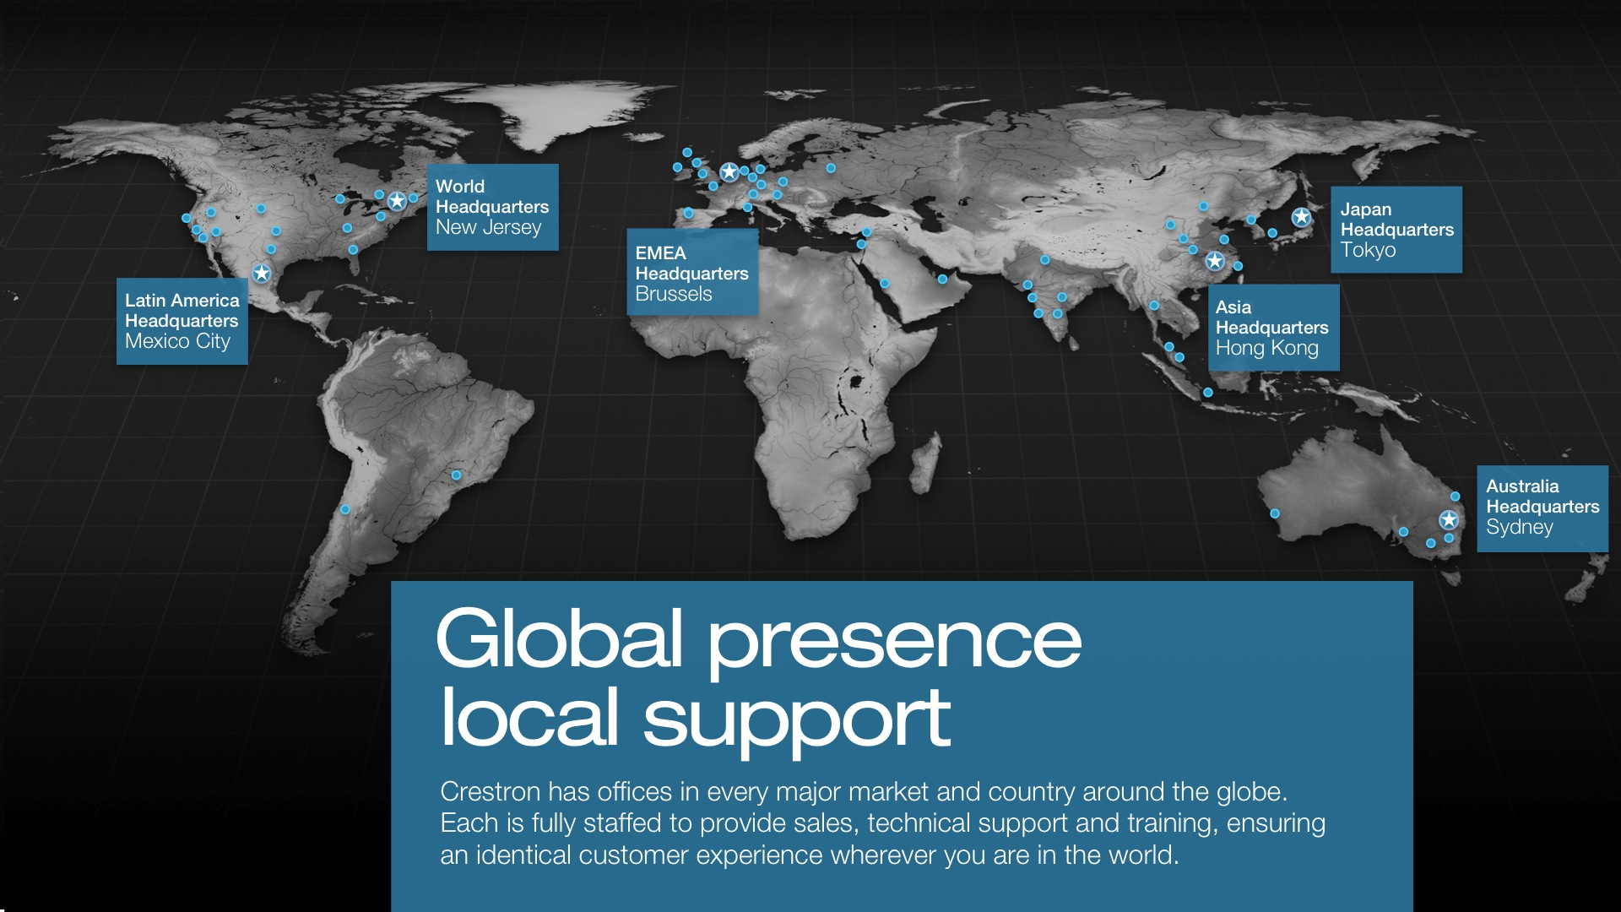

Slide 9


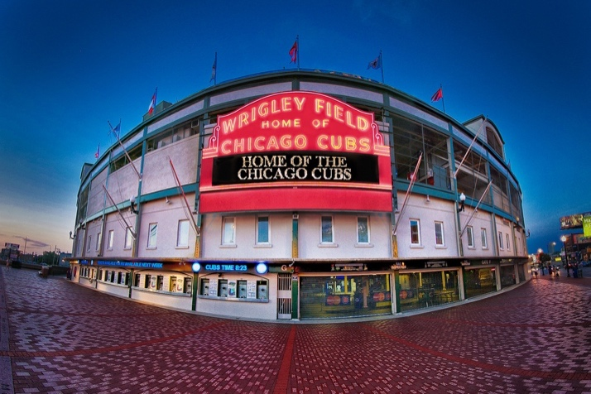

History of Crestron Commercial Lighting
Often viewed as difficult, complex and expensive. Why?
  Crestron has long been known for our ability to do:
  Large high-rise projects
  Sports arenas and stadiums
  Hospitals
  Courthouses
Why are they harder?
  Everything is custom
  Submittals, Programming, Design

Slide 10
Commercial Lighting in the past!
2017 Survey of North America about Crestron Lighting
  Question: Crestron’s biggest Strength? Quality of product! Just works every time
  Question: Crestron's biggest Weakness? Service model for startup

Slide 11
Commercial Lighting in the past!
2017 Survey of North America about Crestron Lighting
  Question: Crestron’s biggest Strength? Quality of product! Just works every time
  Question: Crestron's biggest Weakness? Service model for startup
  Why?
  Impossible to properly scale from one location
  Lack of ability to locally PM
  Expensive need to fly people into markets caused delays
?

Slide 12
Crestron Commercial Lighting Today!
Service Model Change
  All agents now are full-service agents
  Provide sales, startup and support
  Crestron has trained all agents to provide services (US & Canada)
Benefits
  Local in-market Project Management
  Faster response time to requests
  Better communication between contractor and startup team
  Factory support back up

Slide 13
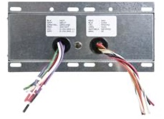
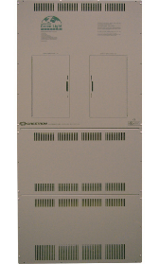
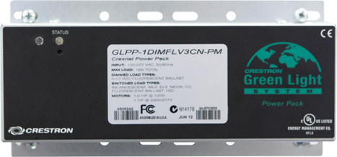
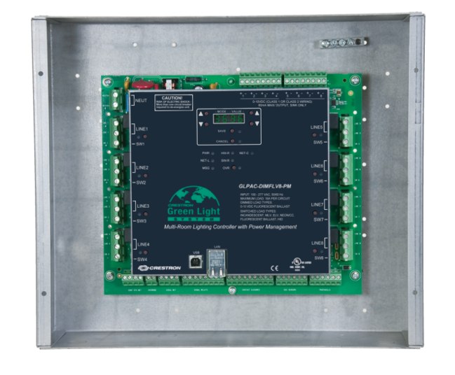
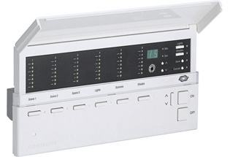
Crestron Commercial Lighting in the past!
Product survey
  Best quality product
  Complete offering of product
  Best lighting to integrate to Crestron AV
  Perception of being expensive
  Product SOLID, but older in design
  Harder to install with use of wire nuts, phoenix connectors, etc.

Slide 14
Crestron Commercial Lighting Today!
In with the old
GLPAC
GLPP
INFINET EX
ILUX
GLS
GLA
CAMEO
LCP
CPP
POE
TSW
PHAROS
Streamlined product
  New products and solutions
  Wireless Distributed Solutions
  Wired Distributed Solutions
  Simplified panels via SpaceBuilder
GLE
GLEX
GLPD
GLXX
DIN
CAEN
Out with the New
Zūm® Solutions
SpaceBuilder®

Slide 15

Crestron Zūm®
Lighting control made easy

Slide 16
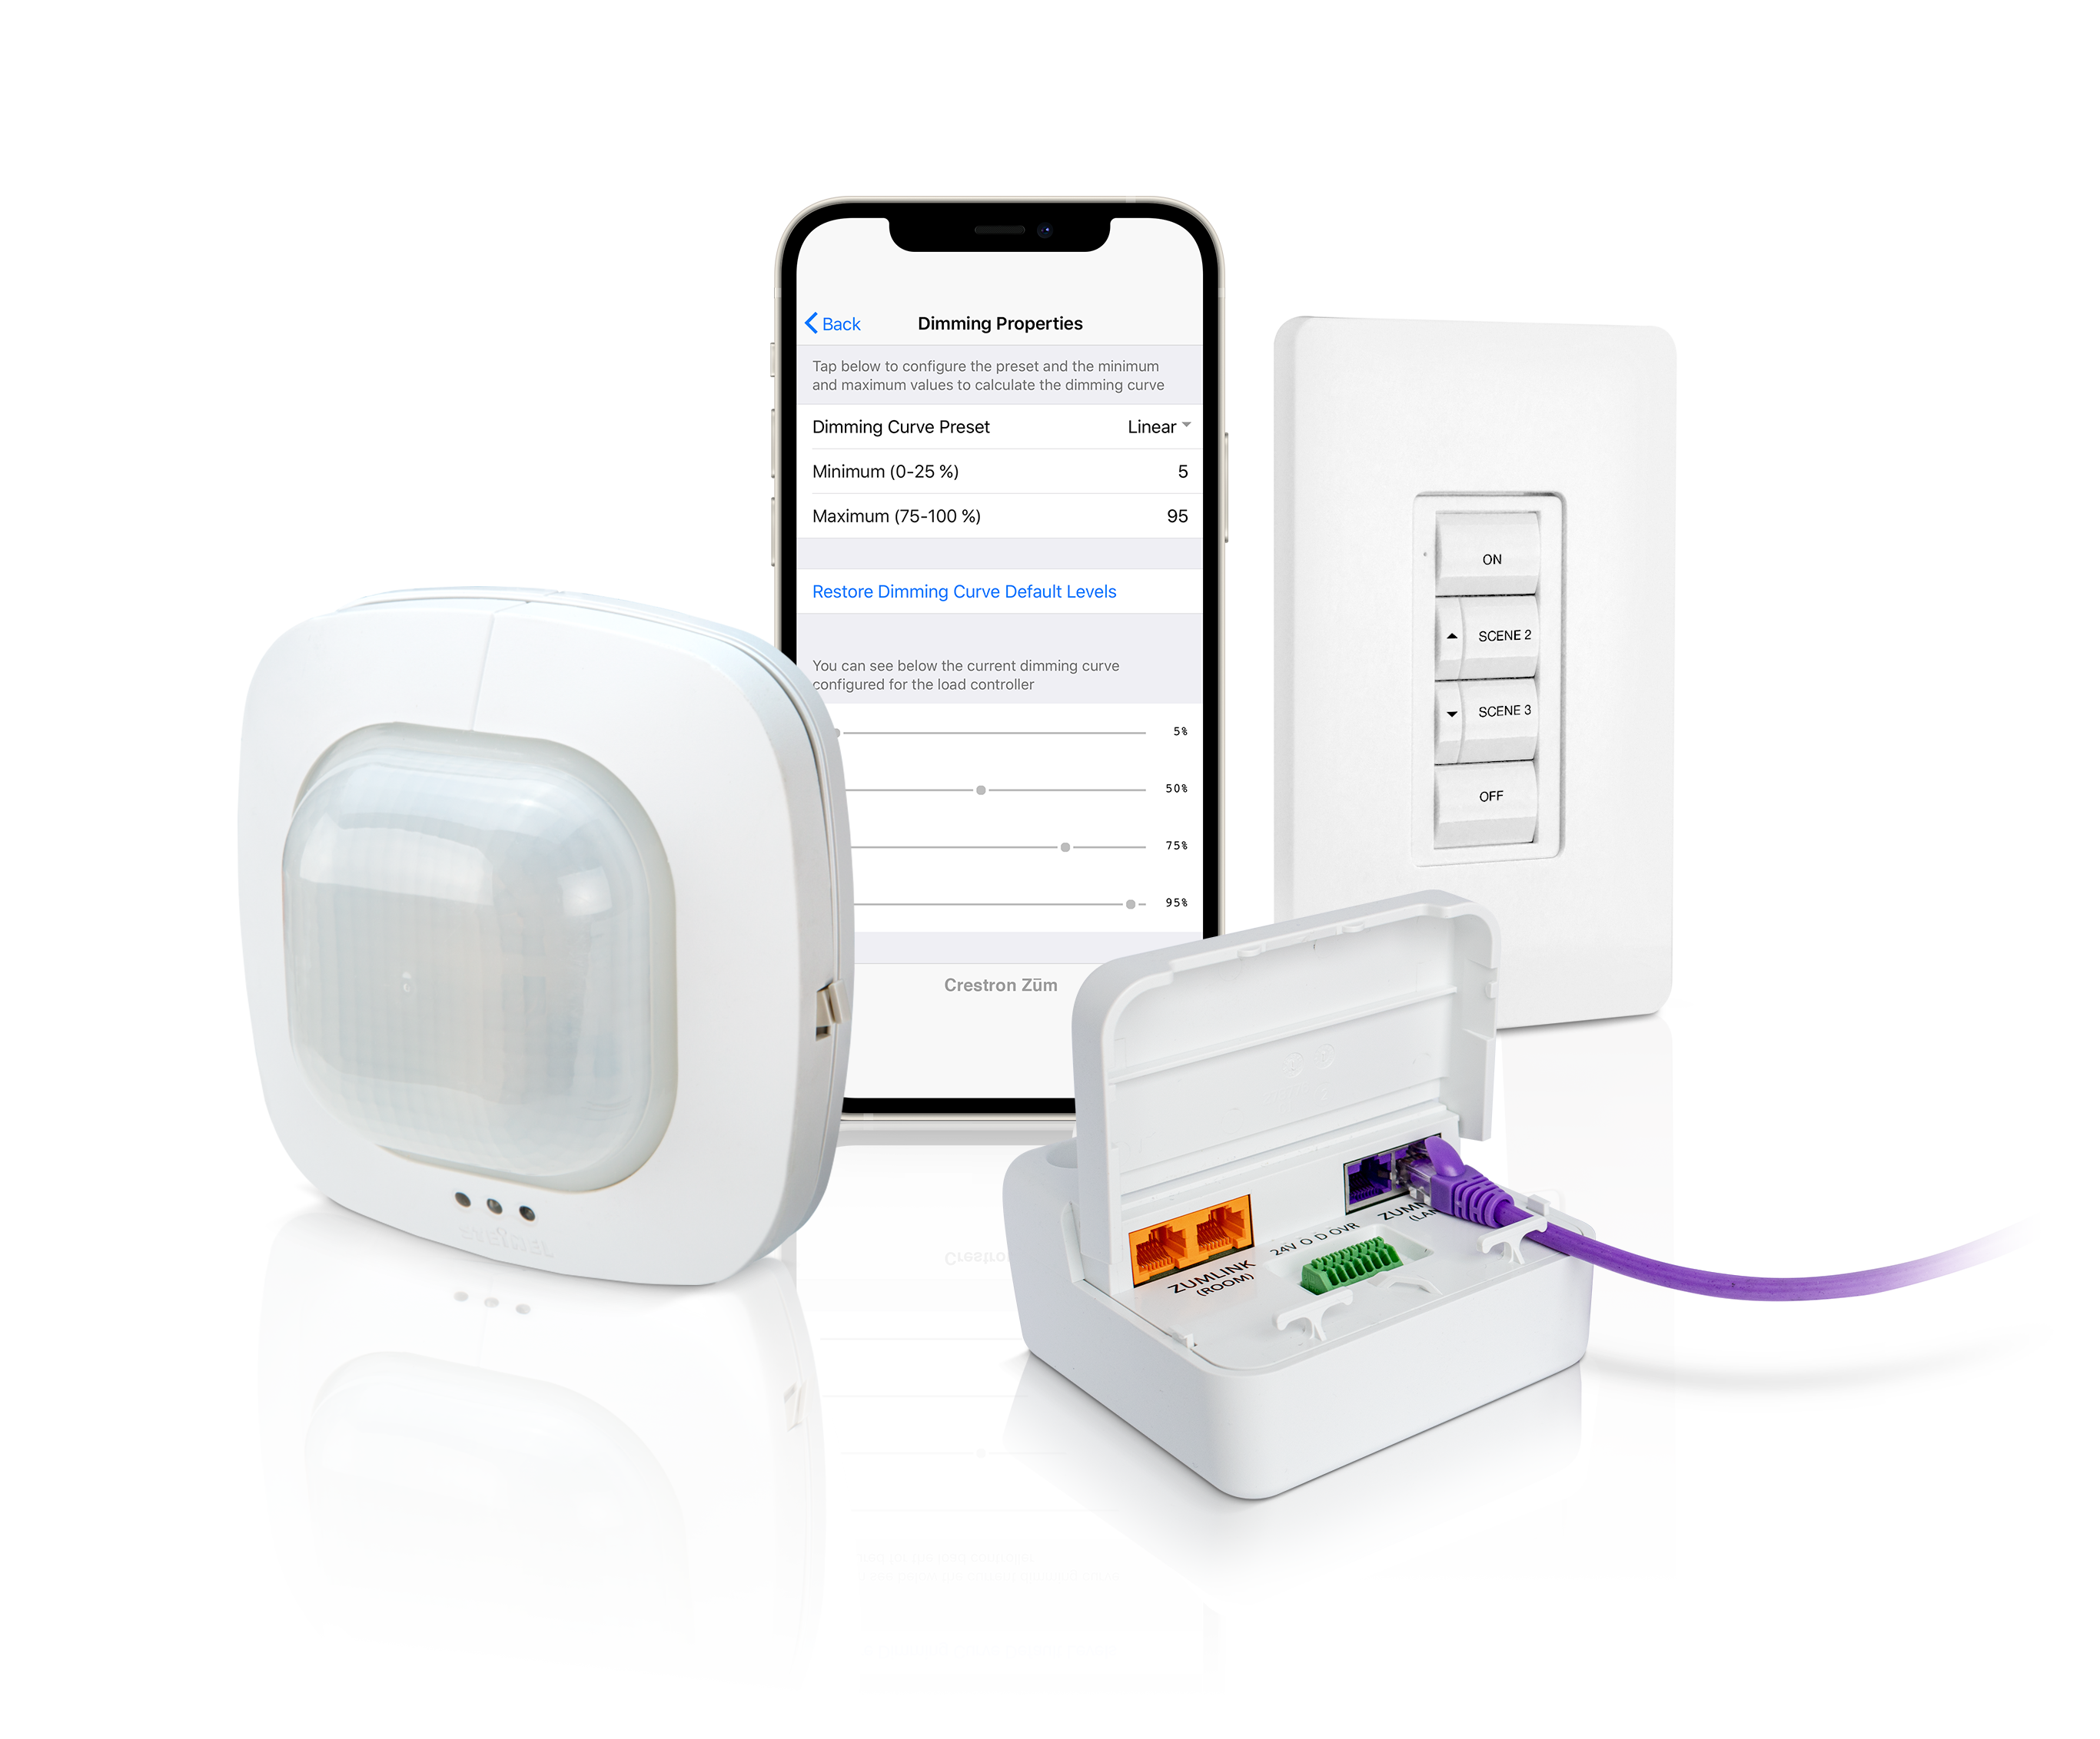

Crestron Zūm: Lighting Control Systems for a New Generation
Lighting Control Made Easy
  Crestron Zūm lighting control systems cover all your requirements on a single platform. With simple design, installation, control and unparalleled scalability, Zūm enables you to control lighting in as many — or as few — spaces as required.

Slide 17
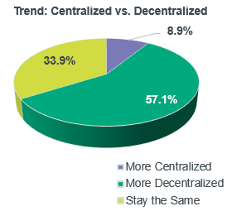
What is Zūm?
2020 Agent Survey of system architecture
Centralized verses Distributed
    Over 90% saw the distributed market growing or staying the same, while only 9% saw growth in their centralized lighting control business.
Proven true by 54% Zūm systems growth in 2020!.

Slide 18
What is Zūm?
New distributed platform of controls
EASY
Easy to design
    Simple J-Box distributed platform
Easy to install
    No complicated wiring. Wireless
    or wired with CAT5 connections
Easy to startup
    No custom programming. All app-based system startup

Slide 19
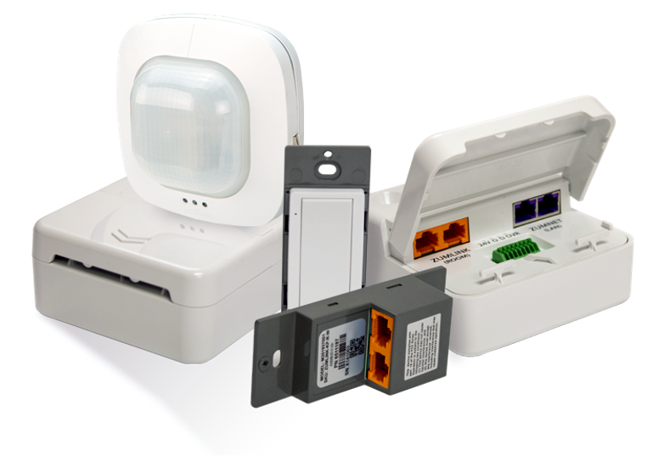
What is Zūm
Zūm wired Solutions
    Only a small number of components:
      J-box load controllers (above ceiling)
      Keypads
      Sensors
        OCC/VAC, Daylight, Part
      Hybrid ability with wireless interfaces or spaces
      Can be stand-alone or networked
      Hub – Central management
      Leveraging the Power of Ethernet
        Ethernet is 10X faster than the old Cresnet RS485 buss

Slide 20
Zūm Roadmap
2022+
Accessories
IO Interface
Wireless Access Point
XIO Cloud management
Additional keypads
DMX
Touch Screen
Beyond
POE Lighting
Zūm Panel
Exterior
?
2021
Phase II (May – June)
4 Series HUB
ZUMLINK Sensors
Adt’l load controllers
App updates
2021
Feb 2021 (initial release of wired)
0-10 V and DALI jBOX
Secondary J-Box load controllers
Keypad
Keypad button trees
Cables
2021

Slide 21
Crestron is a name that is known by end users!
    Crestron AV and UC Flex systems are found in many fortune 500 companies in meeting rooms and huddle rooms.
    UC Flex and other Crestron systems are tied to client Enterprise Network for system management
    Meeting rooms, huddle rooms, etc only represent approximately 12% of a building footprint.

Slide 22
Why Enterprise IoT lighting?
    Lighting control is the one sub-system in a building that covers 100% of a building’s square-footage.
    Many benefits arrive from having the lighting system run on an Enterprise IoT backbone
      Increased system size with less infrastructure hardware
      IoT data network for data collection
      Faster installation, deployment and management of devices and assets

Slide 23
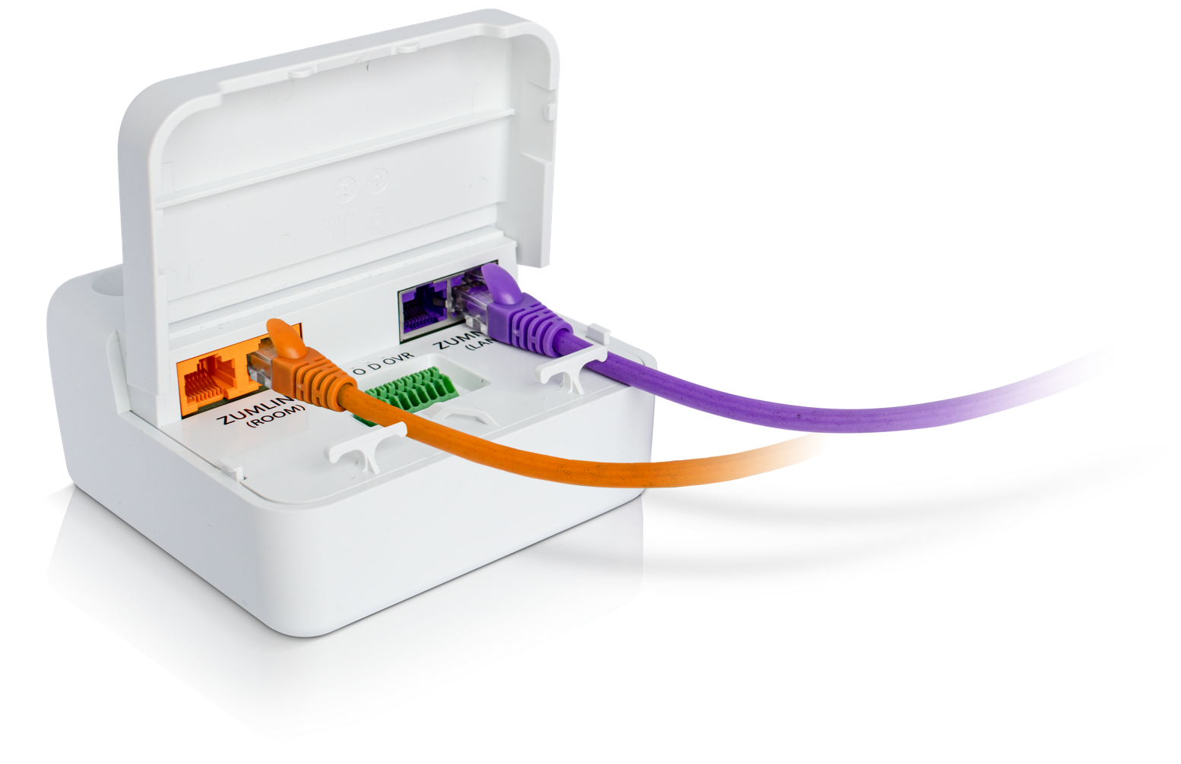
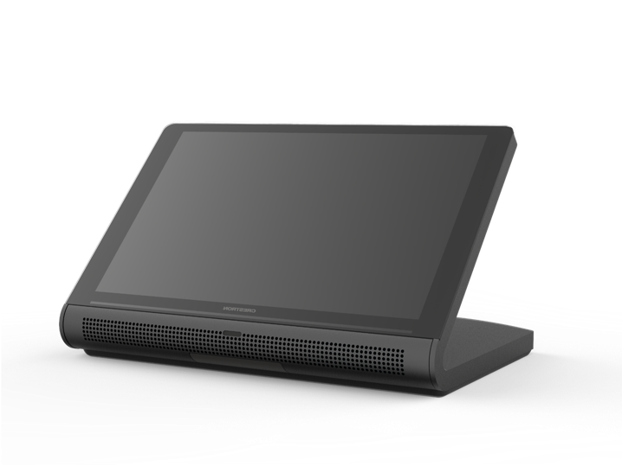
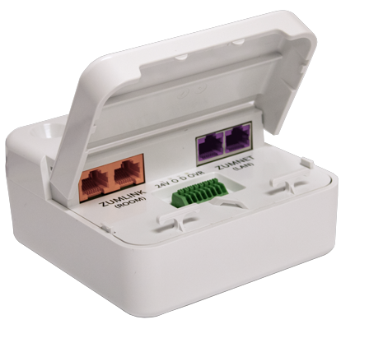
Zūm Enterprise IoT lighting
    Finally, a lighting control system that can be managed and deployed the way IT professionals expect
    Low cost – ability to scale system to size capacity incapable by outdated technology
    Low installation time per room
    Consistent and simple
    Network provisioning and management
    Secure – devices, data
    Lighting control that leverages the Power of Ethernet
    Standard Ethernet infrastructure
CUSTOMER NETWORK
Crestron Enterprise UC
Crestron Zūm Enterprise IoT lighting

Slide 24
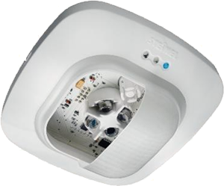

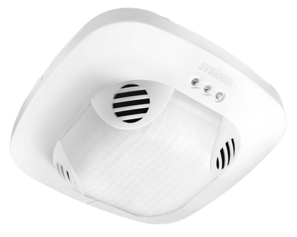
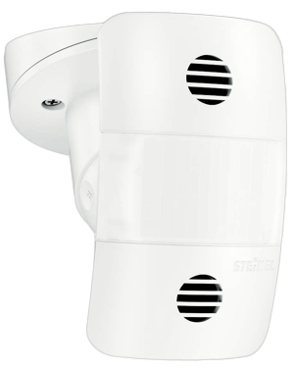
Zūm Enterprise IoT lighting
    The Zūm Enterprise IoT ZUMNET network becomes the data highway for information
    Lighting system data
    Increased sensor data
    Environmental sensors
      CO2, Temp, air pressure, etc.
    People Counting
    BLE way finding
    Acoustical sensors
      Gun shot
    Energy usage and monitoring
BLE way finding
Occupancy and space usage
Lighting system info and energy usage
People Counting

Slide 25
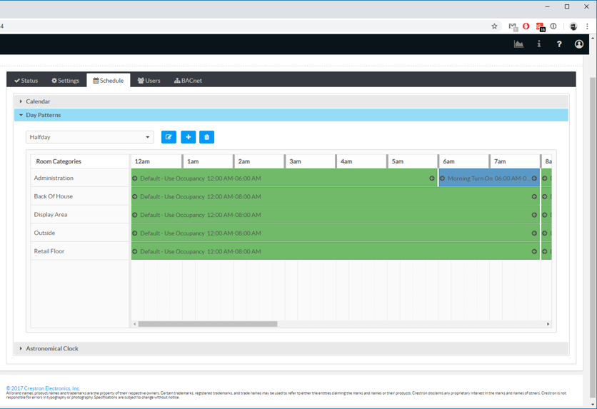
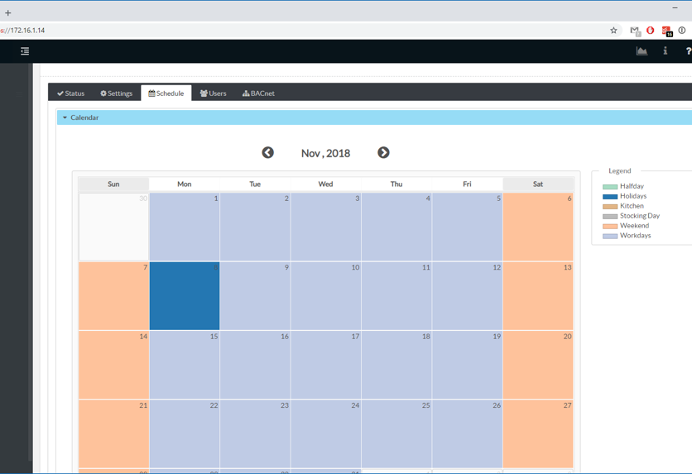
Zūm Enterprise IoT lighting
    System management
    Web-based user interface
    See any room status, including occupancy, battery life (if wireless) and activity
    Manage demand response to meet T24, IECC and ASHRAE code requirements
    Direct BACnet over IP data stack with quick deployment
    Dedicated control subnet
    Gigabit Ethernet networking
    Enterprise-grade security

Slide 26

What is Zūm?
Control
0-10V
DALI
Zūm wired solution (networked)
    Power of Ethernet?
      Crestron introduced Ethernet into control systems in 1998.
      22 Years of Ethernet and controls history
      Zūm wired uses Ethernet as the backbone of communication
        10X faster than Cresnet RS485 network
      Increase in system efficiency resulting in better system resource scaling
      Provides Open Protocol communication speed and IOT management with real world fixture control planforms. 0-10V, DALI, DMX…..
      Ethernet provides advanced commissioning and startup options. Scripting and mac address loading
Ethernet in/out
Local devices
Keypads
Sensors
Loads
WAP

Slide 27
What is Zūm?
Ethernet in/out
Zūm wired solution – IOT backbone
    Real world benefits
      System scalability is increased between 4 to 160 times larger than conventional lighting systems that use old RS485 network connections.
        Zūm wired with HUB, IOS or Android app-based programming with HUB oversight management
        Zūm Custom, Custom programing for special needs using a single 4 series Crestron processor
      Simply put - fewer processors means lower cost and a simpler system to build, configure and install.
This chart shows maximum number of devices (keypads, load controllers, sensors) that can be put on one system processor for networked systems.

Slide 28

What is Zūm?
Ethernet in/out
Zūm wired solution – IOT backbone
    Real-world benefits
      Ethernet backbone allows the lighting system to be used as IOT connection network for many data points beyond lighting.
        Occupancy
        People counting
        Environmental sensors, CO2, Air Pressure, other
        BLE beacons for waypoint finding
        Acoustical sensors, gun shot, etc.
      While Ethernet backbone provides this IOT connectivity, the Zūm system manages existing and future control formats providing the best value in lighting control with IOT.

Slide 29
What is Zūm?
Ethernet in/out
Zūm wired solutions– IOT backbone
    Real-world benefits
      Advanced system programming, start-up, upgrades and long-term support.
      Ethernet backbone means:
        Code can be loaded quickly from central head-end.
        Devices can be managed on IT DHCP server for service and support
        Firmware updates can be scheduled and loaded automatically without the need for onsite support, reducing human touch
        Remote device support can be accomplished by local agent or factory

Slide 30

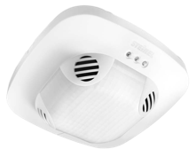
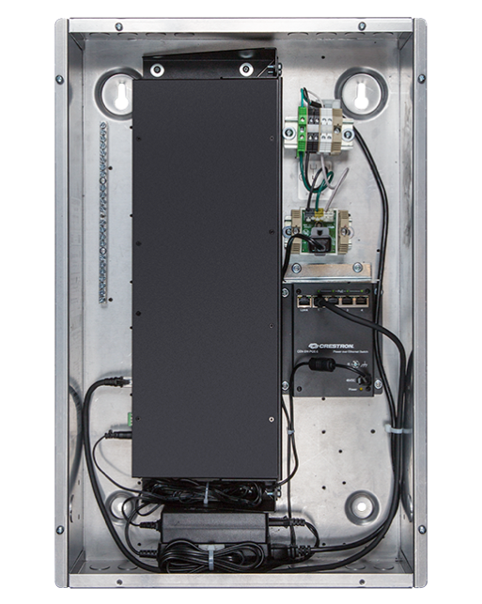
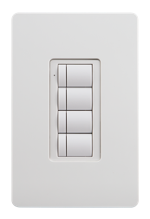
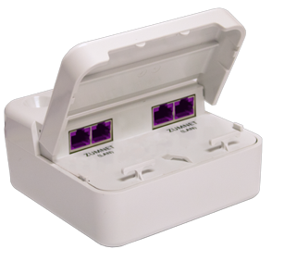
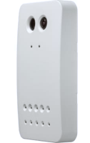
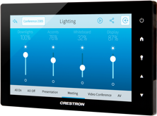
What is Zūm?
Zūm Enterprise IoT network
Cloud Managment
Space
Space
Space
Space
Up to 20 rooms
Ethernet / ZUMNET
Zūm partner sensor
Local control / ZUMLINK

Slide 31
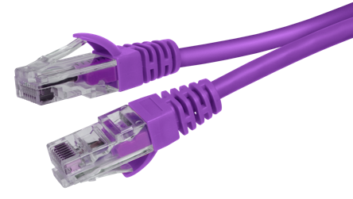
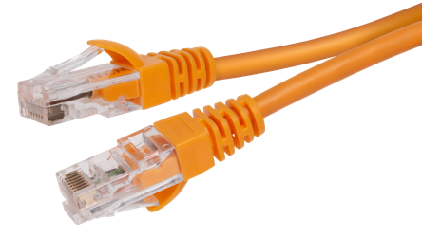
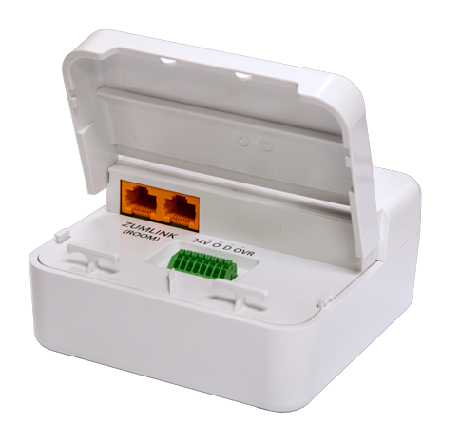
What is Zūm?
ZUMNET Load
Controller with Network
Zūm wired Solution – Stand-alone
    Remember that Zūm systems don’t have to be networked!
    Programmed with IOS or Android app
      BLE to radio in keypad
    Room based programming for stand-alone
ZUMLINK Load Controller

Slide 32
Zūm Wired Solutions
Load Controllers
    Knockout-mounted with wire leads for quick install
    Plenum-rated case
    Universal 120 - 277 VAC input
    Ethernet in/out for backhaul communication
    RJ45 ZUMLINK connection for keypads, sensors and accessories
    Built in IO port for non-Zūmlink sensors or UL924 Override
    Load types:
      ZUMNET level
        DALI
        0-10V (16A)
        0-10V (16A Emergency “EM” version with shunt relay, for UL924 compliance)
      ZUMLINK level
        0-10V (16A)
        Plug Load Control
        Switching (16A)
        0-10V (16A Economy “Lite” version)
ZUMNET Load
Controller with Network
Q1 2020 Release
ZUMNET-JBOX-DALI
ZUMNET-JBOX-16A-LV
ZUMLINK-JBOX-16A-LV
ZUMNET-JBOX-20A-PLUG
ZUMLINK-JBOX-20A-SW
Post-Q1 2021 Release
ZUMLINK-JBOX-16A-LV-LITE
ZUMNET-JBOX-LV-16-EM
ZUMLINK Load Controller

Slide 33
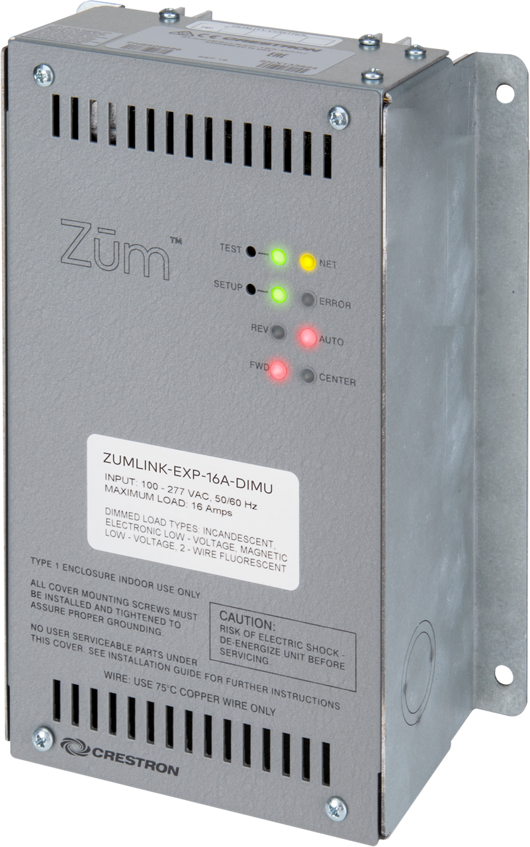
Zūm Wired Solutions
Universal Phase Load Controller
    ZUMLINK-EXP-16A-DIMU
    ZUMLINK communication
    Knockout feeds
    Plenum-rated case
    Universal 120 - 277 VAC input
    Load types:
      2-wire universal phase dimming (20A)
      Forward or Reverse phase

Slide 34
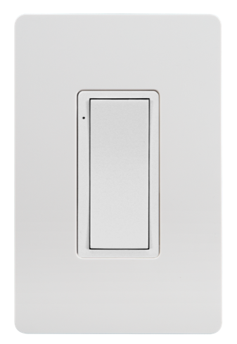
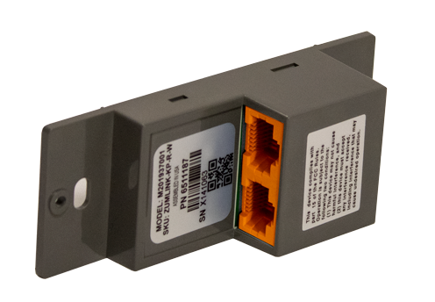
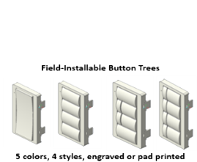
Zūm Wired Solutions
Keypads
    ZUMLINK wired communication
    Rocker, 4, 6 & 8 button options
    Pad printed or custom engravable
    Interchangeable button trees change model from rocker to multi-button
    Built-in BLE radio for startup connection
    Five color options
      White, Black, Almond, Gray, Red
2020 Release
ZUMLINK-KP-R-W
2020 Release
ZUMLINK-BTN4-X
ZUMLINK-BTN-6-X
ZUMLINK-BTN-8-X
ZUMLINK-BTN4-X-ENGRAVED
ZUMLINK-BTN-6-X-ENGRAVED
ZUMLINK-BTN-8-X-ENGRAVED
X = COLOR

Slide 35
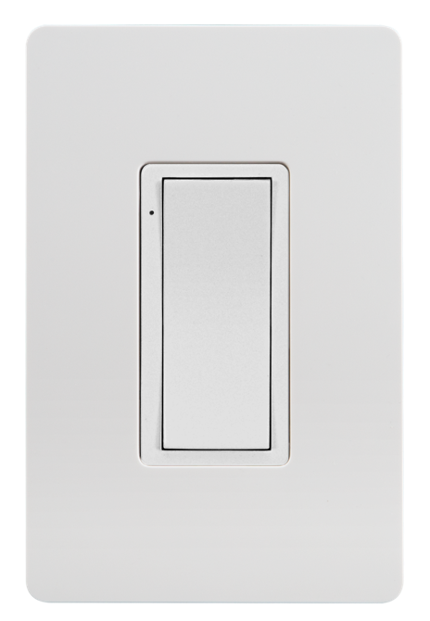

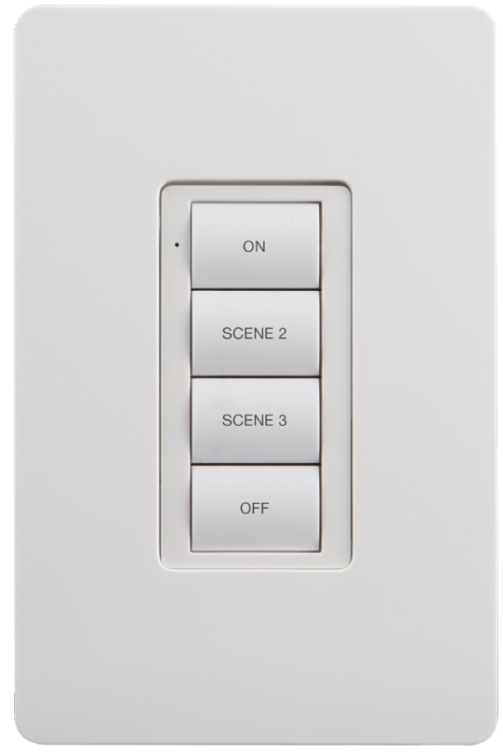
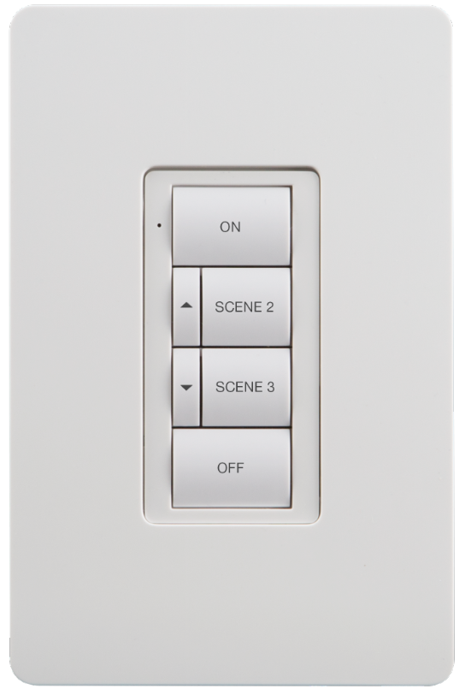
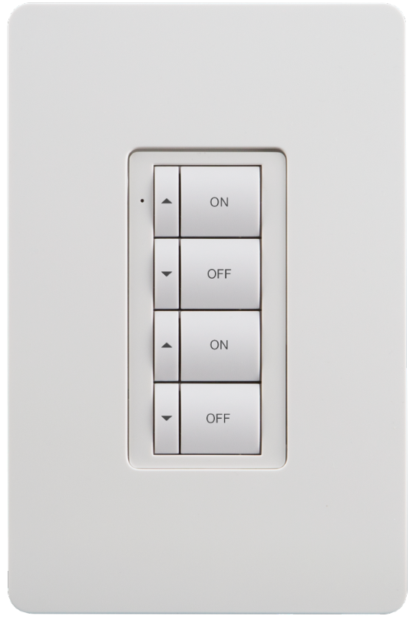
Zūm Wired Solutions
Keypads
    ZUMLINK-KP-R-W
      Commissioning via Zūm App and BLE radio
    ZUMLINK wired communication
    Rocker, 4, 6 & 8 button options
    Pad printed or custom engravable
    Interchangeable button trees change model from rocker to multi button
    Five color options
      White, Black, Almond, Gray, Red

Slide 36
Zūm Wired Solutions
Keypads (Q3 2021 Release)
    ZUMLINK-KP-R-W-LED
      Commissioning via Zūm App and BLE radio
    ZUMLINK wired communication
    Rocker, 4, 6 & 8 button options
    Pad printed or custom engravable
    Interchangeable button trees change model from rocker to multi button
    Additional LED feedback
    Five color options
      White, Black, Almond, Gray, Red

Slide 37

Zūm Wired Solutions
(Q3 2021 Release)
    ZUMLINK-KP-R-W-LED-GV
    ZUMLINK wired communication
    Rocker, 4, 6 & 8 button options
    Pad printed or custom engravable
    Interchangeable button trees change model from rocker to multi button
    USB input rather than BLE radio (good for government jobs)
    Additional LED feedback
    Five color options
      White, Black, Almond, Gray, Red

Slide 38
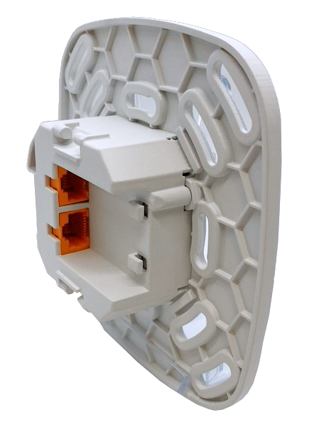
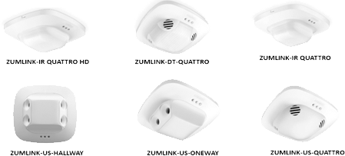
Zūm Wired Solutions
Sensors
    ZUMLINK CAT5 WIRING
      PIR
      PIR HD (4000 SF COVERAGE)
      ULTRASONIC
      DUAL TECH
      ULTRASONIC HALLWAY AND ONE WAY
    Built in Day Light Sensor for Daylight Harvesting
    Optional RLY version for VAV relay
ZUMLINK-IR-QUATRO-DLS
ZUMLINK-IR-QUATRO-HD-DLS
ZUMLINK-US-QUATRO-DLS
ZUMLINK-DT-QUATRO-DLS
ZUMLINK-US-HALLWAY-DLS
ZUMLINK-US-ONEWAY-DLS
For relay option add –RLY to part number

Slide 39
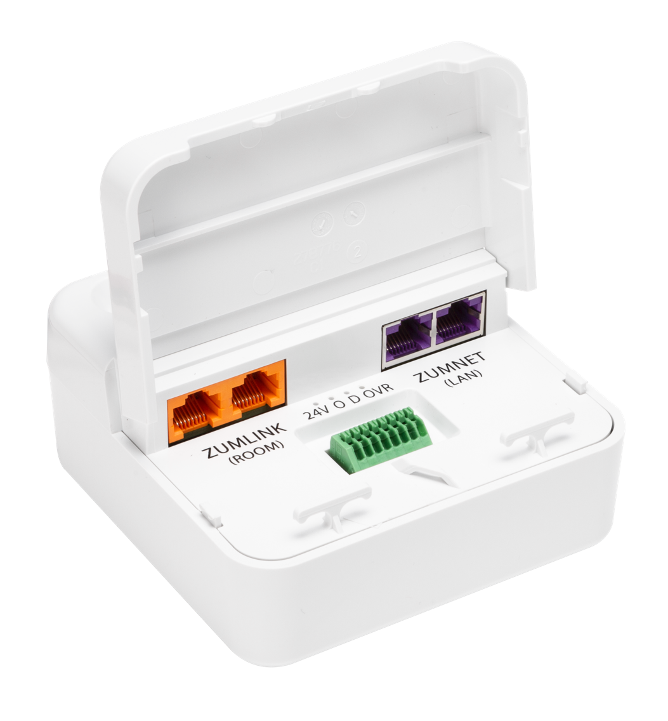

Zūm Wired Solutions
Sensors (flexibility)
    Using non-ZUMLINK sensors
    Use built in SIM-IO in J-Box Controller
      Corner-mount sensors
      High-Bay sensors
      Exterior Sensors
      Daylight/Photo sensor

Slide 40
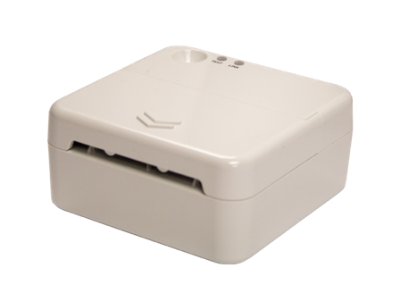

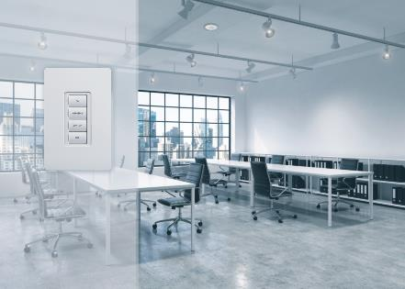


Zūm Wired Solutions
ZAP
    ZūmMesh wireless Access Point
    ZūmLink CAT5 WIRING in/out
    Provides cross connection of ZūmMesh devices to a wired system
      KEYPADS
      SENSORS
      Wall box load controllers
      ZUMMESH-PART (requires system to be networked)
    Round puck design
    Mount in standard 4 square box or clip mount
BOX WITH ZAP
CEILING
APPROX 3”

Slide 41
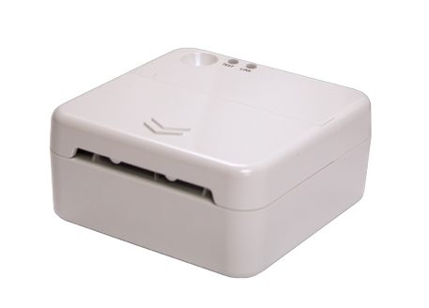
Zūm Wired Solutions
Auxiliary Interface Devices
    ZUMLINK-AI
    ZūmLink CAT5 WIRING
    4 square box mounting
    Can mount forward or reverse for conduit applications
    Provides 2 CC inputs, 4 CC outputs, 1 RS232
      Use for shades, AV, hospital bed pillow speakers
BOX WITH AI
CEILING

Slide 42
Zūm Wired Solutions
Key Switch
    Package product KIT
    ZUMLINK-KEYSW-MOM-KIT
    ZUMLINK-KEYSW-MAIN-KIT
    Zūm™ Link CAT5 WIRING Via Aux Interface
    Use of AI, also has additional ports
      3 in, 2 out + RS232
+

Slide 43
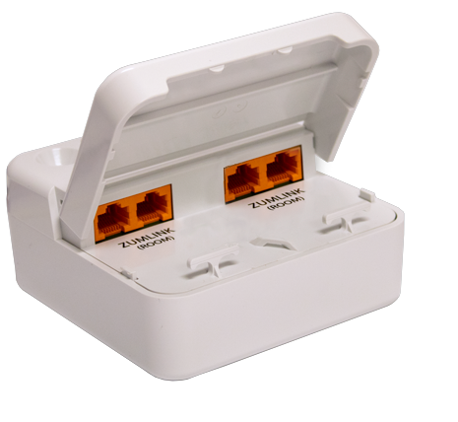
Zūm Wired Solutions
Power Supply
    ZUMLINK-JBOX-PSU
      Adds additional Zūm™ Link power to the “Link” buss for keypads, sensors or other devices
      Use when more power is needed on Zūm™ Link line
        Large open office with multiple sensors
        Hallway with single load and multiple sensors
      4 RJ45 link connections to provide multiple lines of separate power (power limit TBD)
Zūm™ Link
power supply
3 Watts
3 Watts
3 Watts
To power keypads and sensors

Slide 44


Zūm Wired Solutions
POE switch
    ZUMNET-SW-POE-4
      Zūm™ wired Jbox design for easy remote mounting
      Non/managed or self/managed POE switch
      4 Ethernet Ports
      Provides easier installation and lower cost than CLP-HUB-SW-POE-10 with more ports!
      Lower cost and faster installation than cabinet switches
Old Way
New Way

Slide 45

Zūm Wired Solutions
Next room
From room
Touch Screen
    Zūm in room Touch Screen
      Built in Zūm control app for 5” & 7” TS
      Support up to 24 zones and 24 DALI Groups
      16 Scene controls
      On/off/Dimming
      Color control for tunable white and DMX
ZUMNET-SW-POE
Zūm™ Net Jbox

Slide 46
Zūm Wired Solutions
ETHERNET
Zūm™ Link
Jbox DMX
    ZUMLINK-JBOX-DMX
      “LINK” level box
      Built in control software for DMX
      ZūmLink control for interfaces
      Ethernet port for programming (NOT ZūmNet)
      Single DMX universe out, 512 channels
DMX OUTPUT

Slide 47
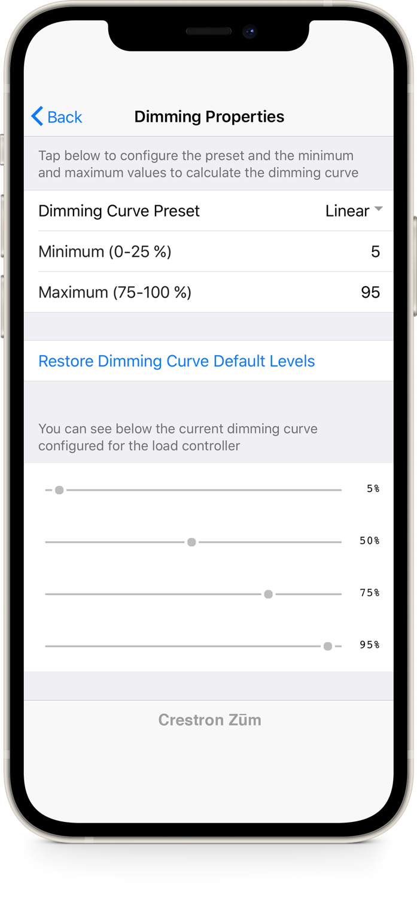

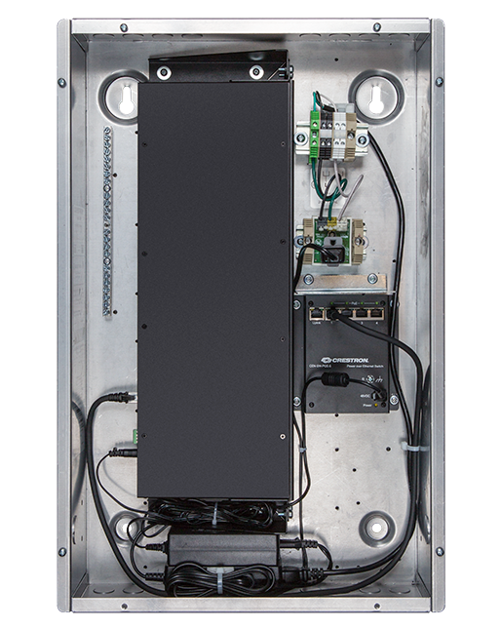
Zūm Wired Solutions
Hub & App
    Update of current Zūm hub to 4 series engine
    RACK mounted or DIN cabinet mounted central processor
    Built-in time clock scheduler
    BACnet over IP built-in with 5,000 objects
    Demand Response
    1,000 rooms
    Single Hub for wired and wireless applications
Significantly updated mobile app
  Auto-discover room devices
  Save Room Configs as Templates
  Apply Templates to other rooms
ZUM-HUB4
Zūm Mobile App

Slide 48


Zūm Wired Solutions
ZUMNET Cables
Cables
ZUMNET cables (Purple)
  Plenum-rated
  25’, 50’, 100’
ZUMLINK cables (orange)
  Plenum-rated
  .5’, 3’, 6’, 12’, 25’, 50’
  10 packs (25’, 12’)
    Provides extended warranty
ZUMLINK Cables
CBL-CAT5E-ZUMNET-P-25
CBL-CAT5E-ZUMNET-P-50
CBL-CAT5E-ZUMNET-P-100
CBL-ZUMLINK-P-0.5
CBL-ZUMLINK-P-3
CBL-ZUMLINK-P-6
CBL-ZUMLINK-P-12
CBL-ZUMLINK-P-25
CBL-ZUMLINK-P-50
CBL-ZUMLINK-P-12-10PK
CBL-ZUMLINK-P-25-10PK

Slide 49

What is Zūm
Cloud management
Data aggregation
  Multiple hubs
  Multiple facilities
Energy monitoring
Room optimization via sensor data
Customizable dashboard
Remote scheduling
Remote system monitoring/control
Market-driven enhancements to app/hub workflow
Completion of aggressive hardware fulfillment from Phase Three
Shipping 2021

Slide 50
Crestron Commercial Lighting Today!
How do we handle those big Jobs?
SpaceBuilder panel
  Simplified system configuration
  Removes the need for “custom” panels
  Integrates to Zūm Hub or custom-programed processors
  4 System options
    Feed thru or MLO
    12OV, 277V and Universal voltage
    0-10V, Relay, HSW and Phase Dimming

Slide 51
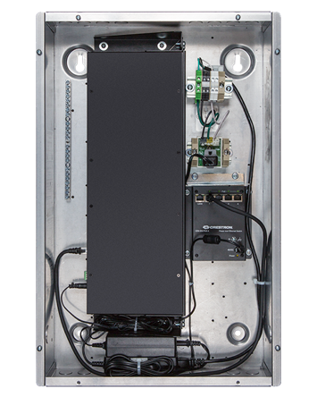
Power of Ethernet
Main control panel
How does this effect other systems
    Power of Ethernet?
      Crestron introduced Ethernet into controls systems back in 1998. 22 Years of Ethernet and controls history
      Zūm wired uses Ethernet as the backbone of communication
        10X faster than Cresnet RS485 network
      Ethernet provides advanced commissioning and startup options. Scripting and mac address loading
      Open protocol
      Provides communication speed and IOT management with real-world fixture control platforms. 0-10V, DALI, DMX…..
Network Crestron or client
Up to 250 SpaceBuilder cabinets with Ethernet Bridge (EN)
Up to 32
Modules
Keypads
Sensors
Up to 32
Modules
Keypads
Sensors
Up to 32
Modules
Keypads
Sensors
System capacity up to 8,000 devices on system

Slide 52
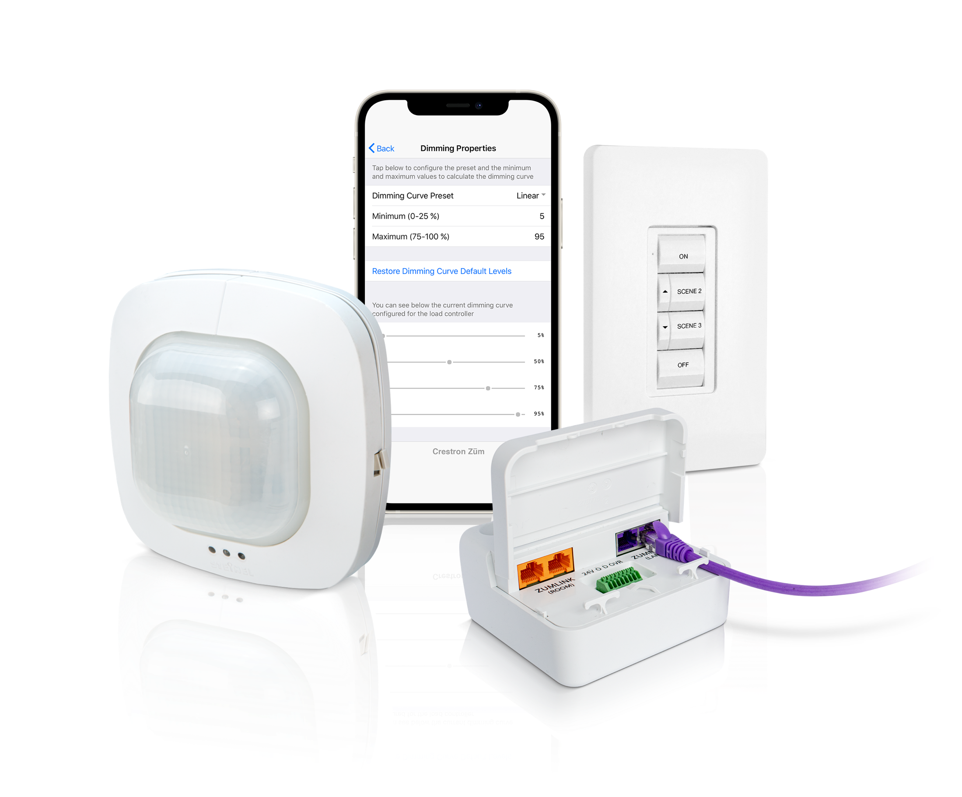
Zūm Wireless Solutions
(shipping since 2017)
    Only a small number of components:
      J-Box load controllers (above ceiling)
      Wall box load controllers (smart dimmers)
      Keypads – Battery or line-voltage
      Sensors – Battery or low-voltage
      Networking bridge and Gateway - (wireless)
      Hub – Central management
      Accessories – IO, WAP, etc.

Slide 53

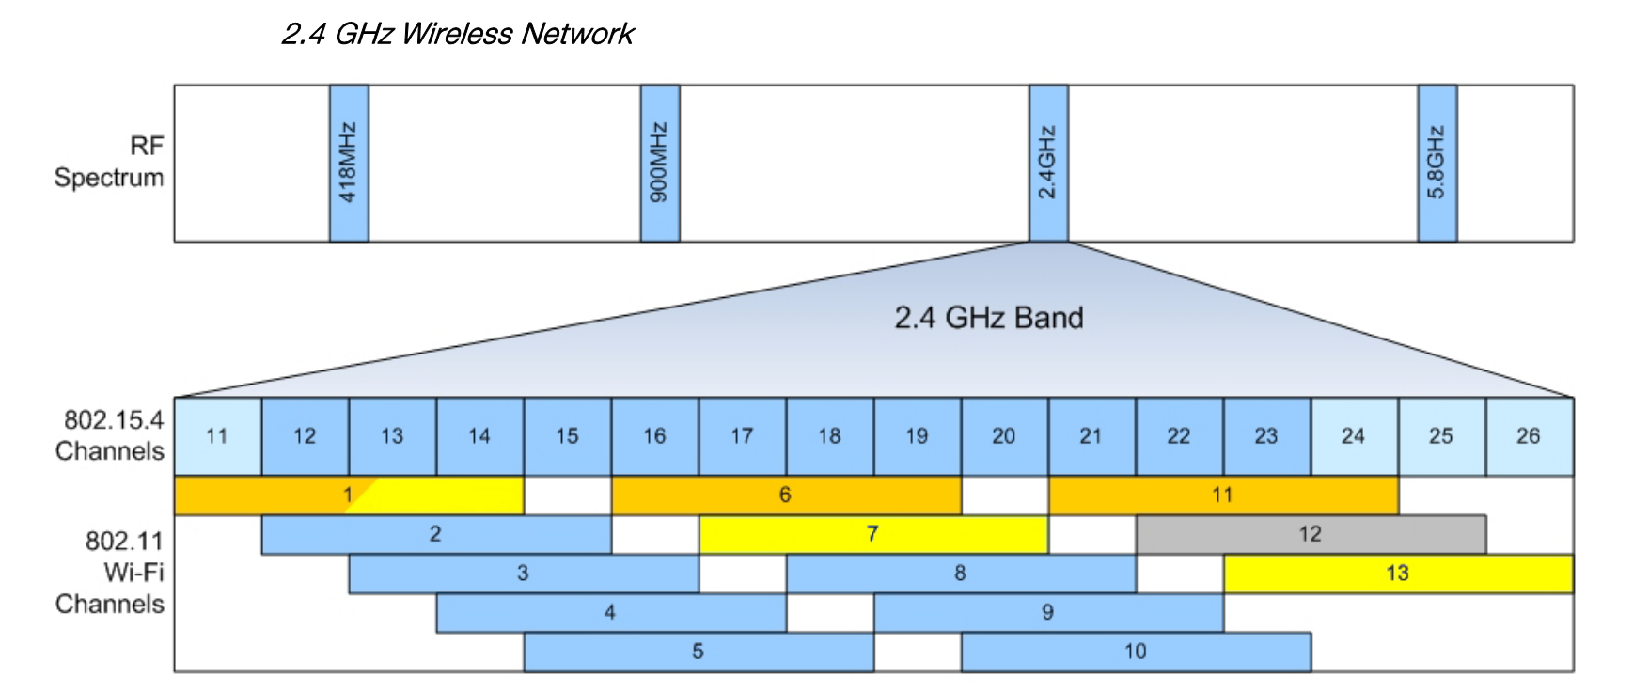
Zūm Wireless Solutions
Zūm wireless Communication
    Devices in the room communicate using modified Zigbee communication – 2.4 GHz (802.15.4)
    RF Channels limited to avoid WI-FI traffic
      Zūm uses channels 15, 20, 25, 26 (802.15.4) which do not overlap with Wi-Fi (802.11) – channel is selected automatically when network is formed
      System automatically switches channels if any signal interference

Slide 54
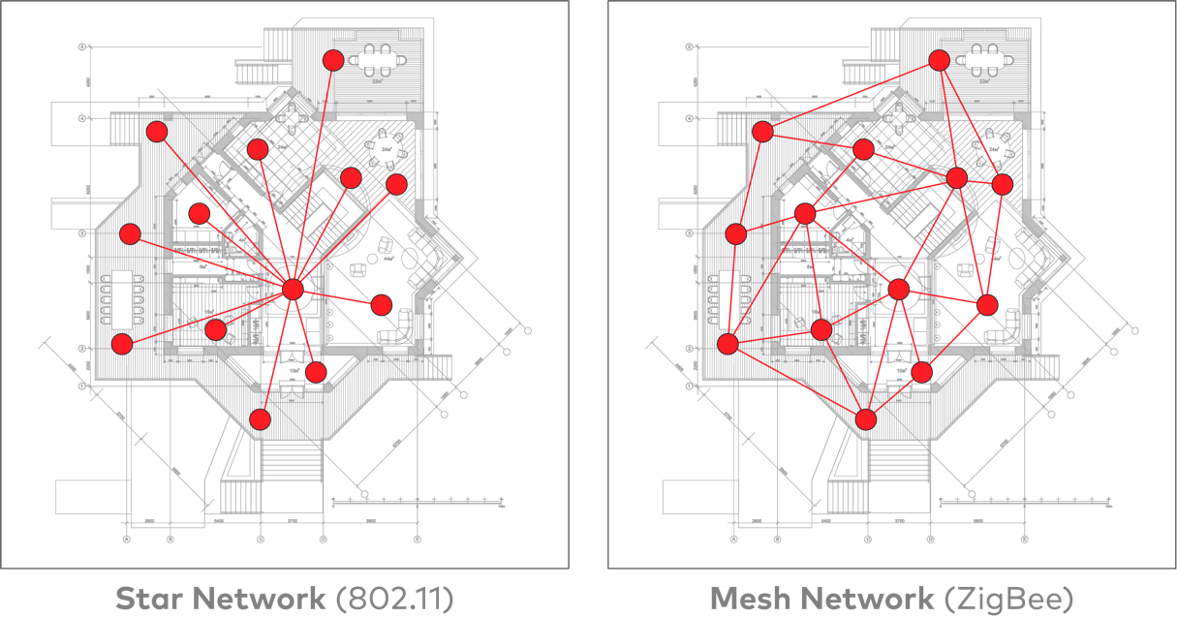
Notes:
POWER - WiFi
BIT RATE
RANGE

Slide 55

Zūm 2.4 GHz: How does it work?
Zūm Wireless Mesh
    Zūm Wireless Mesh works inside of spaces
    Devices can create own Peer-to-Peer
    mesh within the space (no processor needed)
    2.4 GHz, 802.15.4 communications with
    AES-128 encryption for security
    End-to-end government approved
    Auto RF channel selection

Slide 56

Zūm 2.4 GHz: How does it work?
Zūm Wireless Mesh
    Zūm Mesh works inside of spaces
    Devices can create peer-to-peer
    mesh within the space (no processor needed)
    2.4 GHz, 802.15.4 communications with
    AES-128 encryption for security
    Auto RF channel selection

Slide 57

So, how does it work?
Zūm wireless uses a distributed system design

Slide 58


Zūm Wireless Solutions
Load Controllers
    Easy to install / wire leads
    Knockout mounted
    Plenum-rated case
    Universal 120 - 277 VAC input
    Load types:
      Switching (16A)
      0-10V dimming (5A or 16A)
      0-10V dimming 16A-EM (Emergency)
      Plug loads (20A) (Isolated control
      for auto-on or occupancy mode)
      DALI
ZUMMESH-JBOX-20A-SW
ZUMMESH-JBOX-16A-LV
ZUMMESH-JBOX-5A-LV
ZUMMESH-JBOX-16A-LV-EM
ZUMMESH-JBOX-20A-PLUG
ZUMMESH-JBOX-DALI

Slide 59

Zūm Wireless Solutions
Universal Phase Controller
    Zūm Mesh wireless communication
    Knockout feeds
    Plenum rated case
    Universal 120 - 277 VAC input
    Load types:
      2-wire universal phase dimming (20A)
      Forward or Reverse phase
ZUMMESH-EXP-16A-DIMU

Slide 60
Zūm Wireless Solutions
0-10V EM controller
    UL 924 device
    Should be powered from Emergency Power source
    Looks and operates like normal 16A JBOX controller
    Will always boot up in EM mode until it hears communication from non EM AC powered device
    Switches to EM when building switches from normal to emergency power
    Requires 600ms brownout at 277V or 125ms for 120V.
    Will keep lights on at 100% for 90 minutes or until normal power returns.

Slide 61

Zūm Wireless Solutions
Wall box controllers
    Zūm Mesh wireless communication
    Standard gangable back box, decorator faceplates
    Universal 120 - 277 VAC input
    White, black, almond, gray, and red
    Load types:
      Switching (16A)
      0-10V dimming (5A)
      2-wire ELV & MLV phase dimming (5A)
ZUMMESH-DIM-X-S
ZUMMESH-DELV-X-S
ZUMMESH--5A-LV-X-S
ZUMMESH-5A-SW-X-S

Slide 62


Zūm Wireless Solutions
Wireless Keypads
    Zūm Mesh wireless communication
    Battery powered
      Rocker, 4 and 6 button options
    Pad printed or custom engravable
    7-Year battery life
    Standard box mount or glass mount
    Five color options
      White, Black, Almond, Gray, Red
With back sticker to adhere to glass
ZUMMESH-KP10ABATT-X-S
ZUMMESH-KP10BBATT-X-S
ZUMMESH-KP-10CBATT-X-S
ZUMMESH-KP-10DBATT-X-S

Slide 63

Zūm Wireless Solutions
Wireless Keypads
    Zūm Mesh wireless communication
    AC (line-voltage) powered
      Rocker and 4 button options
    Pad printed or custom engravable
    Five color options
      White, Black, Almond, Gray, Red
ZUMMESH-KP10A-X-S
ZUMMESH-KP10B-X-S

Slide 64



Zūm Wireless Solutions
Wireless Sensors
    Battery-powered Occupancy or Vacancy sensor
      10-Year battery life
      500 SF coverage pattern PIR
    Battery-powered daylight sensor
      Dual loop for fast setup
      10-year battery life
      One sensor can control multiple zones to meet code
ZUMMESH-PIR-OCCUPANCY-BATT
ZUMMESH-PIR-VACANCY-BATT
ZUMMESH-OL-PHOTOCELL-BATT

Slide 65





Zūm Wireless Solutions
Wired -to- Wireless Sensors
    Low-voltage Occupancy or Vacancy integration
    Provides 24V power to sensor(s) removing need for battery sensor
    Provides use of advanced sensor on wireless platform
      Dual Tech sensors
      Ultrasonic Sensors
      Hallway sensors
      Large scale PIR sensors
ZUMMESH-JBOX-SIM

Slide 66

Zūm Wireless Solutions
Wired -to- Wireless Sensors
    4000 SF coverage pattern
      Same coverage area as 8 battery-operated PIR sensors
    Low-voltage NS sensor for use WITH SpaceBuilder™ systems, Zūm, and others
    PIR Presence Detection
    Set-up with remote
    Vacancy or occupancy mode
    HVAC relay option available (2nd relay)
GLA-IR-QUATTRO-PRO-HD

Slide 67

Zūm Wireless Solutions
Wireless Sensors - Partition
    Enables room combining for Zūm Spaces
    Ceiling or wall mountable
    Single-gang US electrical box or Surface Mount
    Decorator-sized opening
    24 Volt DC powered (sold separately)
    Diffuse reflective infrared technology
ZUMMESH-PART

Slide 68

Zūm Wireless Solutions
Wireless 3rd party interface
    USB powered
    Can connect to any Zūm space as
    one of the 32 device
    Provides RS-232/USB connection for
    AV control of lighting
      Crestron AV
      Other brand AV
ZUMMESH-AVBRIDGE

Slide 69

What is Zūm
As stand-alone system (examples)
  As simple as two products
    Wall box and sensor

Slide 70

What is Zūm
As stand-alone system (examples)
  As simple as two products
    Wall box and sensor
  As many as 32 products
    Wall box controllers
    J-Box controllers
    Sensors
    Keypads

Slide 71
Zūm Wireless Solutions
Wireless Networking
    Networking is the process of connecting multiple rooms to a central head end.
    Networking is done for 4 primary reasons
      Global system management
      Master time clock schedule
      Demand response
      BACnet interface to HVAC

Slide 72

Zūm Wireless Solutions
Wireless Networking
    Starts with the space or room
      Network any space by simply adding a network bridge onto a J-Box load controller.
      Only ONE bridge per space
      Provides wireless backhaul communication to network head end
      BLE radio for APP set up
ZUMMESH-NETBRIDGE

Slide 73



Zūm Wireless Solutions
Wireless Networking
    Gateways gather up spaces
      PoE powered (Power over Ethernet)
      Wirelessly connects up to 50 Zūm Network Bridges to the Hub
      Does not need to be exposed or visible
      Plenum-rated
      300ft max distance from PoE Switch
FRONT VIEW
REAR VIEW
ZUMNET-GATEWAY

Slide 74
Zūm Wireless Solutions
Wireless Networking
    Zūm hub panel manages network
      Appliance-grade device. No servers
      Supports up to 1,000 spaces or rooms
        Each space or room can have 32 devices for a max. of 32,000 system devices!
      Can support up to 30 gateways (antennas)
        Each gateway = 196,000sf
        Max system = 5,880,000 sf
      Backwards compatible with legacy systems
        Relay or dimming panels
        DMX systems
GLNET-ZUM

Slide 75
Zūm Wireless Solutions
Wireless Networking
    Zūm hub panel manages network
      Provides BACnet over IP integration
      Demand response built-in
      Dynamic scheduling via web browser
      System information reporting – battery life
      802.1X, TLS1.2 and Management Authentication
      Crestron XIO Cloud management Microsoft AZUR
GLNET-ZUM

Slide 76

Zūm Wireless Solutions
Wireless Networking
    Up to 50 Zūm Bridges per Gateway
    Up to 1000 Zūm Bridges (spaces) per Zūm Hub
    Up to 100 feet between Zūm Bridges
    Up to 250 feet between furthest
    Zūm Bridge and Zūm Gateway
    2.4 GHz Wi-Fi friendly wireless
    mesh technology

Slide 77




Zūm Wireless Solutions
Wireless Networking
250’ max between
Gateway and furthest Network Bridge
100’ max between
Gateway and first Network Bridge
100’ max between Network Bridges
100’ max between Network Bridges

Slide 78

What is Zūm
Wireless Networking
To compare performance, cost, and ease of installation, let’s use the following example:
    Example Office Floor Approx - 22,500 sf per floor
      This Floor Plan requires 4 of the competitors point-to-point HUBS
    Competitor’s Limitations
      4 point-to-point hubs per floor w/10,000 sf coverage per hub
      System maxes out at 64 hubs
      Average of 25 rooms/spaces per floor
      Based on this example - Only 16 floors of building can be covered – SYSTEM IS MAXED OUT
    Crestron
      One HUB
      1 Gateway per floor with 196,000 sf coverage
      Average of 25 rooms/spaces per floor
      Full Building Control covering 30 floors

Slide 79
What is Zūm
Wireless Networking
To compare performance, cost, and ease of installation, let’s use the following example:
    Example Office Floor Approx - 22,500 sf per floor
      This Floor Plan requires 4 of the competitors point-to-point HUBS
    Competitor’s Limitations
      4 point-to-point hubs per floor w/10,000 sf coverage per hub
      System maxes out at 64 hubs
      Average of 25 rooms/spaces per floor
      Based on this example - Only 16 floors of building can be covered – SYSTEM IS MAXED OUT
    Crestron
      One HUB
      1 Gateway per floor with 196,000 sf coverage
      Average of 25 rooms/spaces per floor
      Full Building Control covering 30 floors

Slide 80


Zūm Wireless Solutions
To next floor or area
Wireless Networking
    Network distribution panels
    Distributed network for Crestron-only system devices such a Zūm Gateways
    Provides 7 POE connections per panel plus in and out ports.
    Keeps lighting system away from any other network switches and communication
From floor below or area
GLP-HUB-SW-POE-10

Slide 81




Zūm Wireless Solutions
Third - ? Floors
Wireless Networking
    Network distribution panels
      Single Zūm hub panel for 1000 rooms
      CAT5 connection to distribution panels as needed
      CAT5 to gateways as needed
      Supports wireless, wired and legacy products
      Isolated Class A or B network
Second Floor
Main Floor
Building network

Slide 82
Zūm Wireless Solutions
Wireless DALI Controller
    15 Zone (group) DALI controller for up to 64 addresses
    Works with Solar Sync for tunable white
      Requires DALI2 Type8 or ELDO “Light shaper” drivers
    Each group counts as one device of 32 devices in space
    Open DALI2 protocol
      More defined protocol, supports color on single channel
    Purple and grey wires for DALI connection
    Requires ZUMMESH-NETBRIDGE to program
    Drivers can be assigned to a single group
    Perfect to meet IECC2018 code requirements
    All DALI groups and assignments via App
    Most cost-effective control system on the market

Slide 83



Zūm Wireless Solutions
IECC2018
96’
  What is it?
  General lighting must be configured to be controlled separately in floor areas not greater than 600 SF within an open plan office space
  0-10V & IECC2018?
  Max number of battery sensors = 8
  Each sensor gets bound to 0-10V 5AJBOX
  Only 1 Jbox needs a NET BRIDGE
1
2
3
4
48’
5
6
7
8
0-10V example
Netbridge

Slide 84
Zūm Wireless Solutions
IECC2018
Zūm DALI & IECC2018
  Control area up to 8 zones
  8 X 600SF = 4,800 SF
    ZUMMESH-JBOX-DALI
    ZUMMESH-JBOX-SIM
    One sensor per 600SF max.
      Use of Steinel gives us options
      PIR, US, DT, ECT

Slide 85
Zūm Wireless Solutions
DALI & IECC2018
96’
  Why 8 zones?
  Each zone counts as one load controller in the total mix of 32. Adding sensors it will take the count to 16. The 0-10V solution maxes out at 16z due to wireless sensors.
  8 zones keeps a consistent design.
1
2
3
4
48’
5
6
7
8

Slide 86


Zūm Wireless Solutions
DALI & IECC2018
96’
Why only SIMs?
  Distance. A 600 SF area is approx. 24x24.
  Your max distance between devices is 50’ so depending on the configuration of space you may have a distance problem. SIMs assure no issues and allow you to use square pattern sensors.
1
2
3
4
48’
5
6
7
8
Netbridge

Slide 87




Zūm Solutions
Easy startup
    Programming DALI with an app
      Select load controller
      Select Zūm DALI
      Select Addressing
2
3
1

Slide 88



Zūm Solutions
Easy startup
    Programming DALI with an app
      Address drivers
      Group drivers
      Name Groups
6
4
5

Slide 89



Zūm Solutions
Easy startup
    Programming DALI with an app
      Add groups/ zones (up to 15)
      Identify drivers
      Assign drivers to groups
      Entire set up in less than 15 min for a typical space
6
8
7

Slide 90
Zūm Solutions
900 SF classroom with 4 zones
DALI best value!
  4 Zone system with Zūm DALI
  1 Jbox to install
  1 JBOX SIM with 4000 SF sensor
  1 ZUMMESH battery daylight sensor
  3 ZUMMESH battery keypads
  EST COST $495
nLight
  4 Jbox controllers to install!
  1 occupancy sensor
  1 daylight sensor
  3 keypads
          EST COST $645
Notes:
PLEASE ADJUST DOLLAR VALUES WITH AGENT IF THIS IS BEING GIVEN TO A DISTRIBUTOR OR ENGINEER

Slide 91



Zūm Solutions
Easy startup
    Programming with an app
      Programming of each space is done from IOS or Android device with simple-to-use app
      No complicated programming or special training required

Slide 92



Zūm Solutions
Easy startup
    Programming with an app
      Find the room
      Adjust room settings

Slide 93



Zūm Solutions
Easy startup
    Programming with an app
      Select keypads
      Program scenes
      Assign to keypad buttons

Slide 94
Zūm Solutions
    Programming with an app
Recall a Scene / Off
  You pick which scene gets recalled (1-16 or Off)
  You can pick which dimmers that button affects
  Tapping recalls the specified scene
  Holding can Save the scene or perform a Raise / Lower
Toggle
  You can pick a single dimmer that is affected
  Tapping toggles the dimmer
  Holding cycle dims the dimmer
Raise / Lower
  Tapping triggers a step up / down
  Holding Ramps Up / Down
  You can pick which dimmers that button affects
Disable Sensors
  Button disables sensors for an hour when tapped
  Button re-enables sensors when held
  Affects all dimmers in the Room
AV Action
  Sends message (button Tap or Hold) to AV Bridge for AV integration
Advanced startup – Still easy!
    Programming with an app
      Advanced programming for 4 and 6 button keypads.
      No new hardware required. Just firmware update on keypad, netbridge and Jbox.
      Use PUF file v1.06.07 or newer

Slide 95

Zūm Solutions
Network setup
  Zūm HUB
  All room data is auto-populated into Zūm hub
  Custom label spaces by Floor and space type
    First Floor
    Second floor
      Nurses Station
      Exam Rooms
      Patient Room
      PR201
      PR202
      PR203

Slide 96

Zūm Solutions
Network setup
  Zūm HUB
  View all room/space status data
  By floor
  By space type
  By individual space

Slide 97

Zūm Solutions
Network setup
  Zūm HUB
  Create custom day pattern schedules
    Weekday
    Work day
    Weekend
    Holiday
    Half day
    Etc.

Slide 98

Zūm Solutions
Network setup
  Zūm HUB
  Apply day patterns to days
  Simply click on a day, and pick the day pattern to apply

Slide 99

Zūm Solutions
Network setup
  Zūm HUB
  BACnet integration is as easy as a click
  Enabled and set BACnet host info
  All BACnet points are created and saved for export automatically
  No license fees or long custom programming time

Slide 100
Crestron the company
A Partner you can trust
  Easy product to design
  Easy product to install
  Easy product to startup
  Leading the industry in new technologies Zūm®
    Solar Sync
    Wired and wireless distributed systems
    Most important we use the Power of Ethernet
  Thank you
Notes:
This is the end slide. All slides behind this are on hyperlinks

